Slide 1
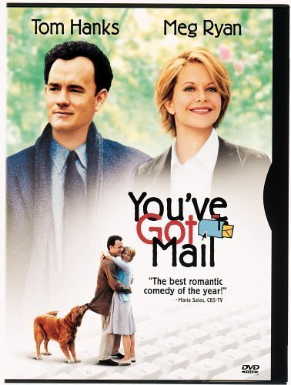
Upper West Side
You’ve got a mail
Mami Sasaki

Slide 2
- Upper West Side -
Between Central Park and the Hudson River
and
Between West 59th Street and West 116th Street

Slide 3
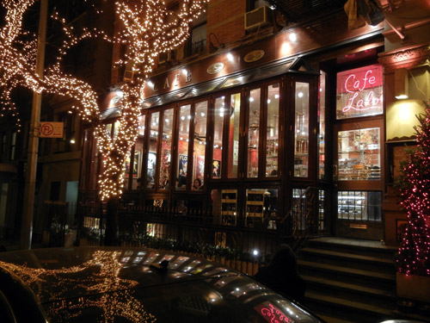
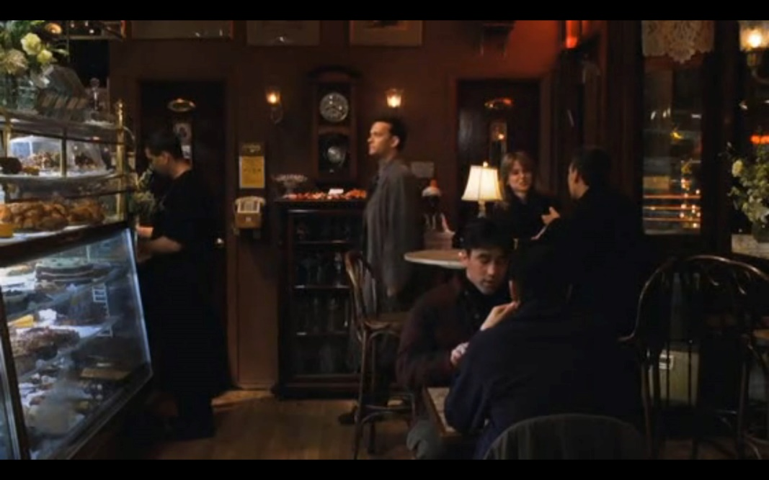
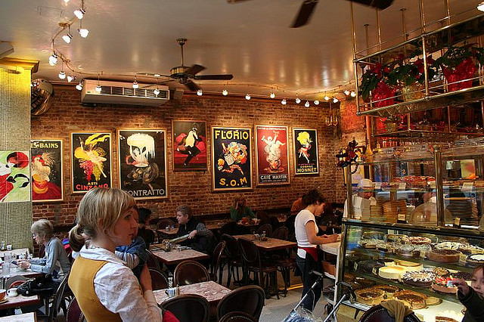
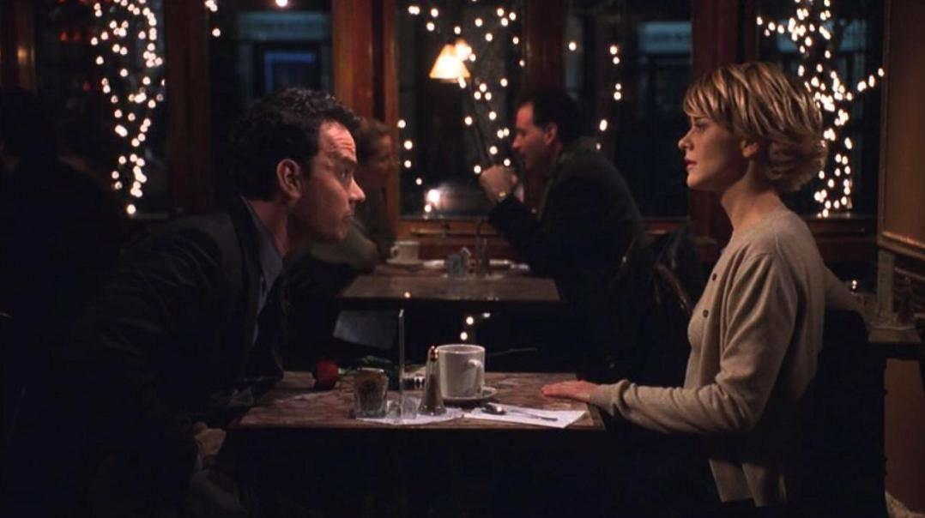
Café LALO
-Amsterdam Avenue at 83rd Street-

Slide 4
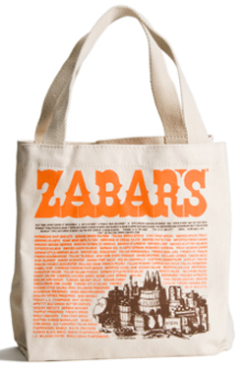
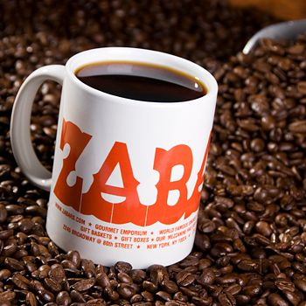
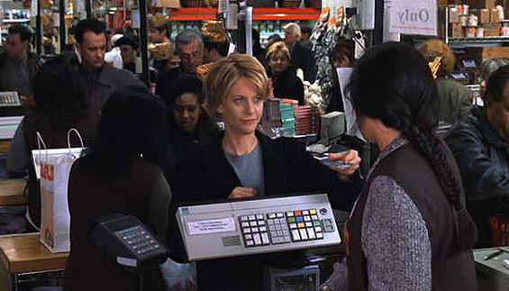
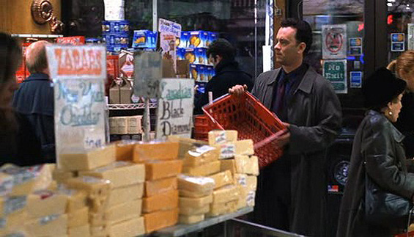
ZABAR’S
-Broadway Avenue at 80th Street-

Slide 5
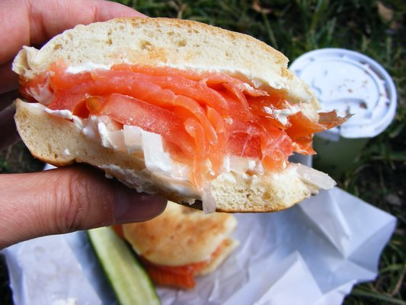
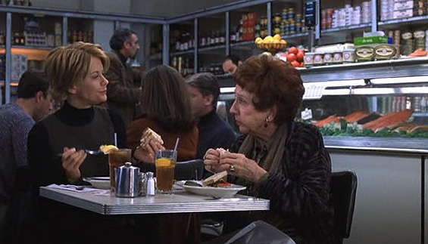
BARNEY GREENGRASS
-Amsterdam Avenue at 86th Street-

Slide 6
Thank you for your attention.

