Slide 1
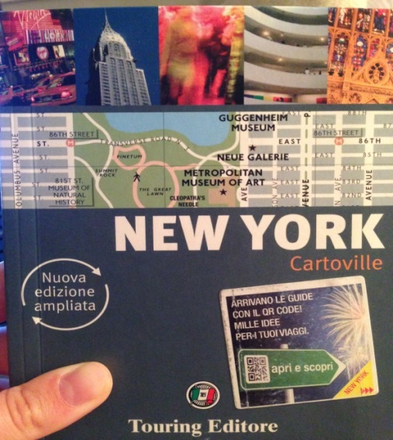
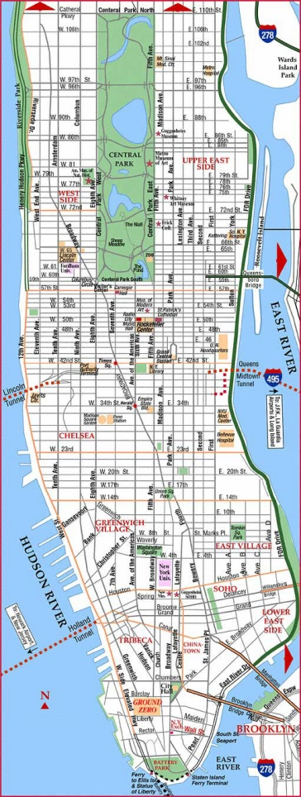
My NYC
My Place love list:
Brooklyn Botanic Garden
State of Liberty
High line
Rockfeller center
Chealsea Market
Brooklyn Williamsburg
Coney Island

Slide 2
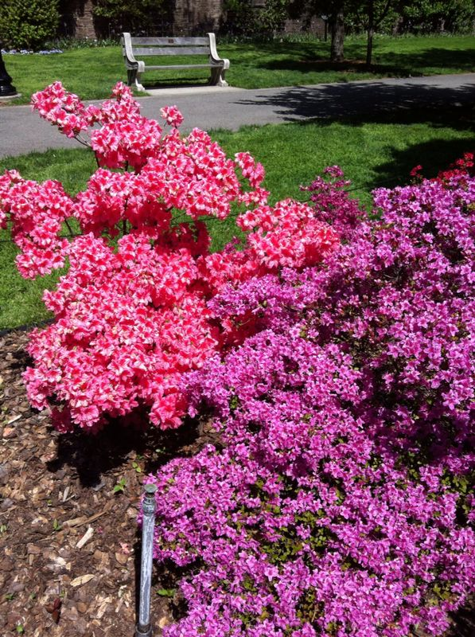
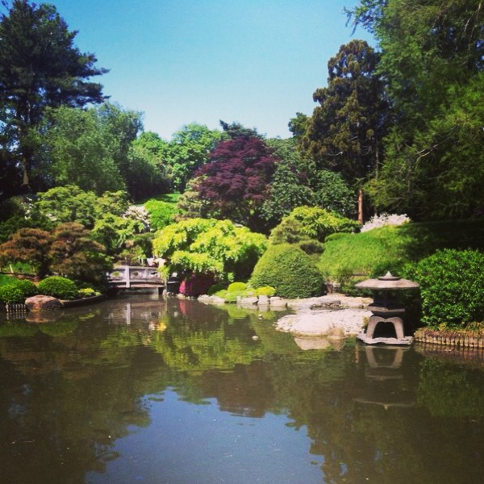
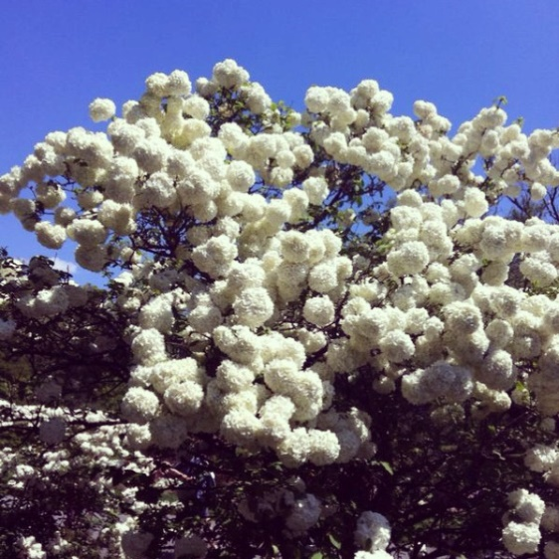
Brooklyn Botanic Garden
How arrive: Take the subway Red line 2 or 3. Get off at Eastern pkwy Brooklyn museum.

Slide 3
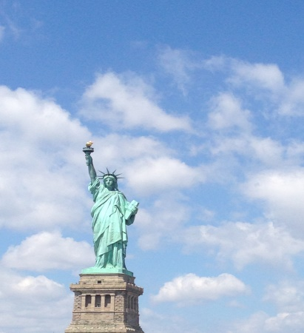
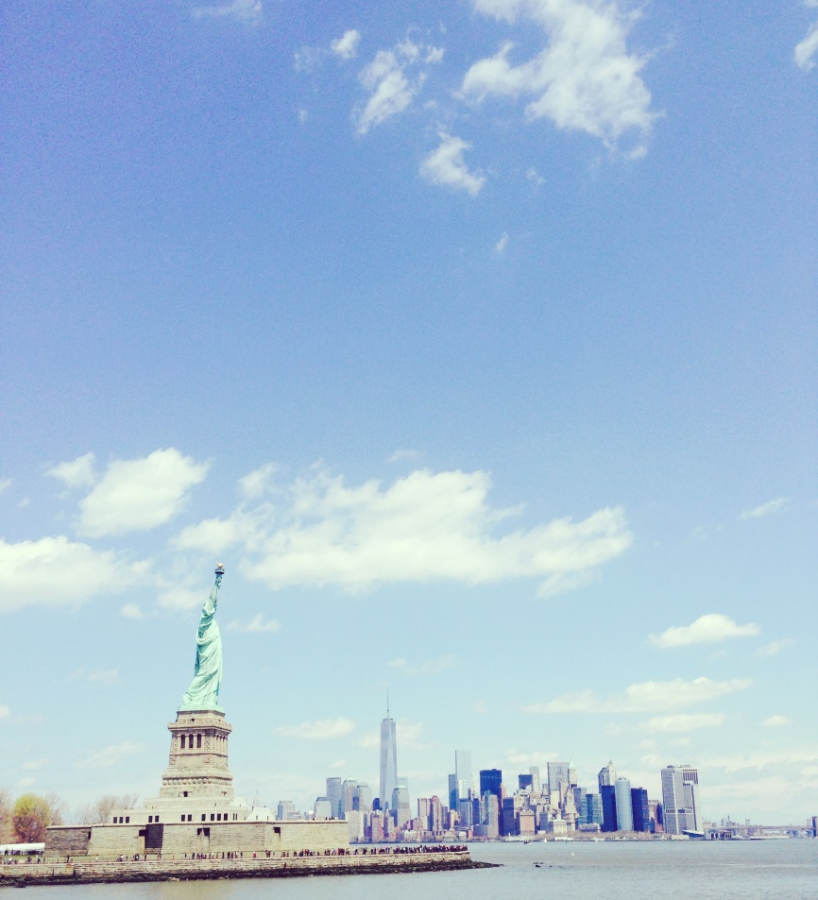
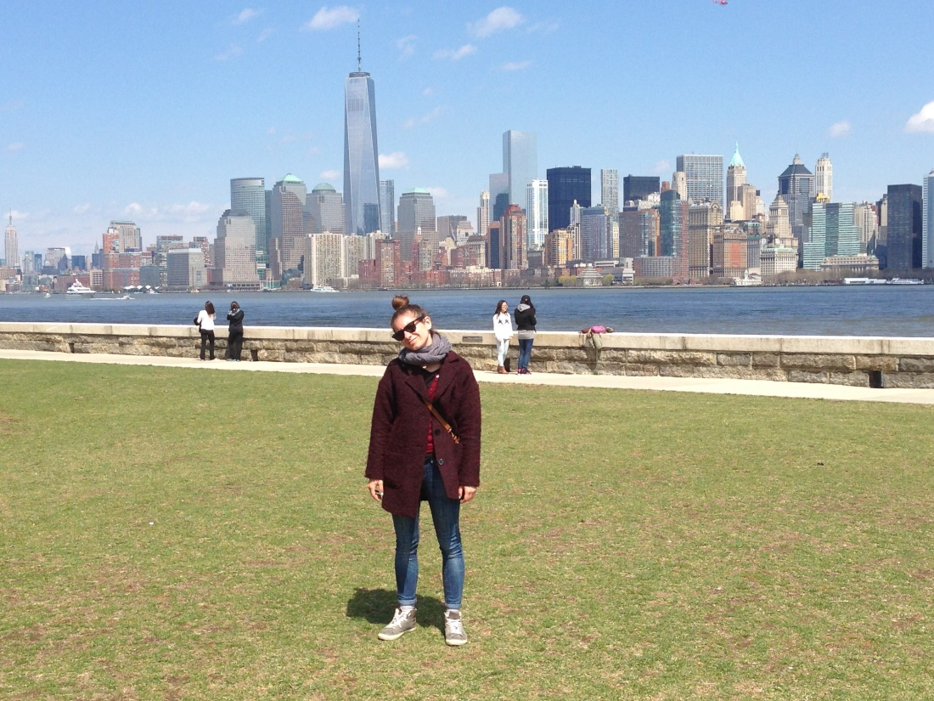
State of Liberty
How arrive: Take the Subway red line 1 until South ferry.
Thake the ferry to Liberty state and Ellis Island 14$.

Slide 4
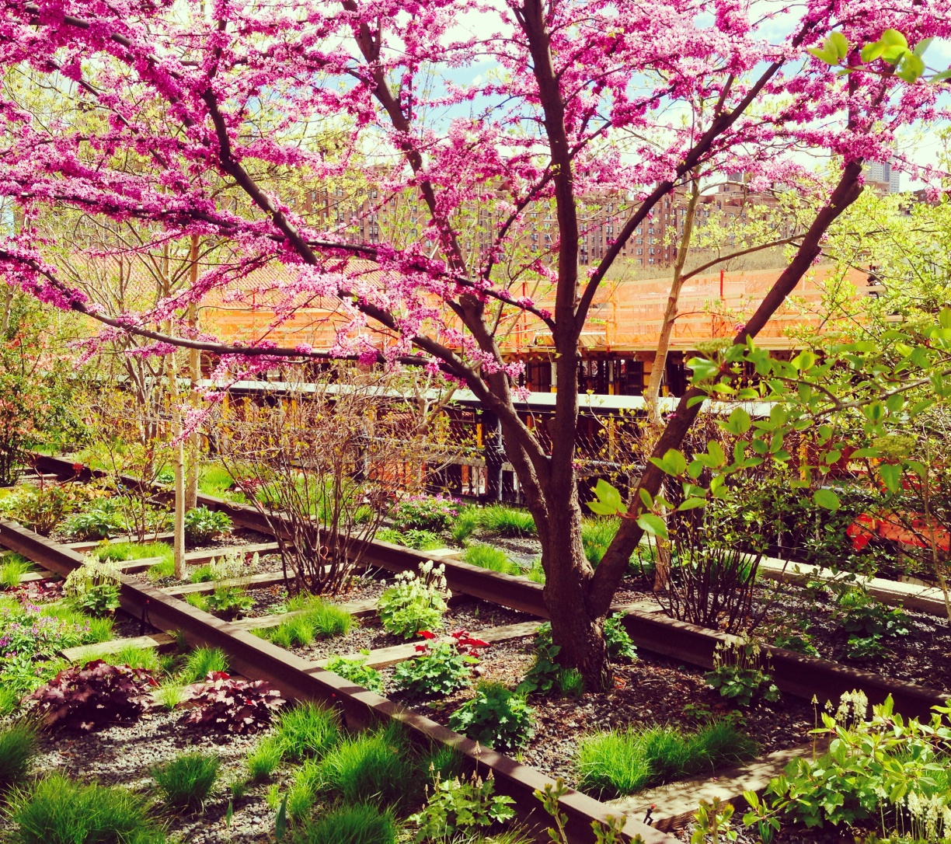
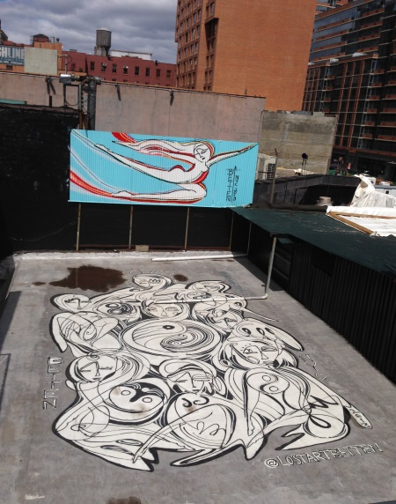
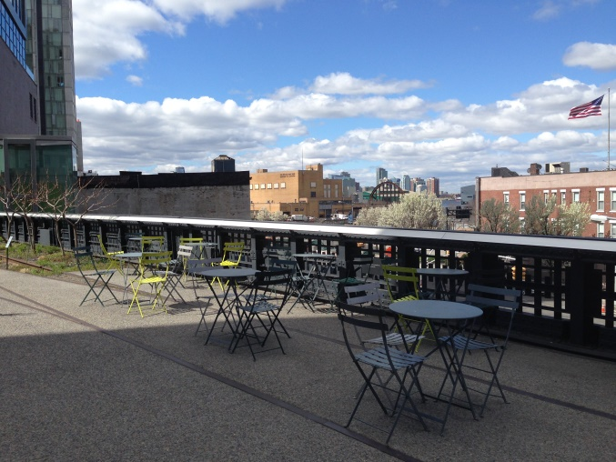
High Line
How arrive: Take the subway and get off at 14 street.

Slide 5
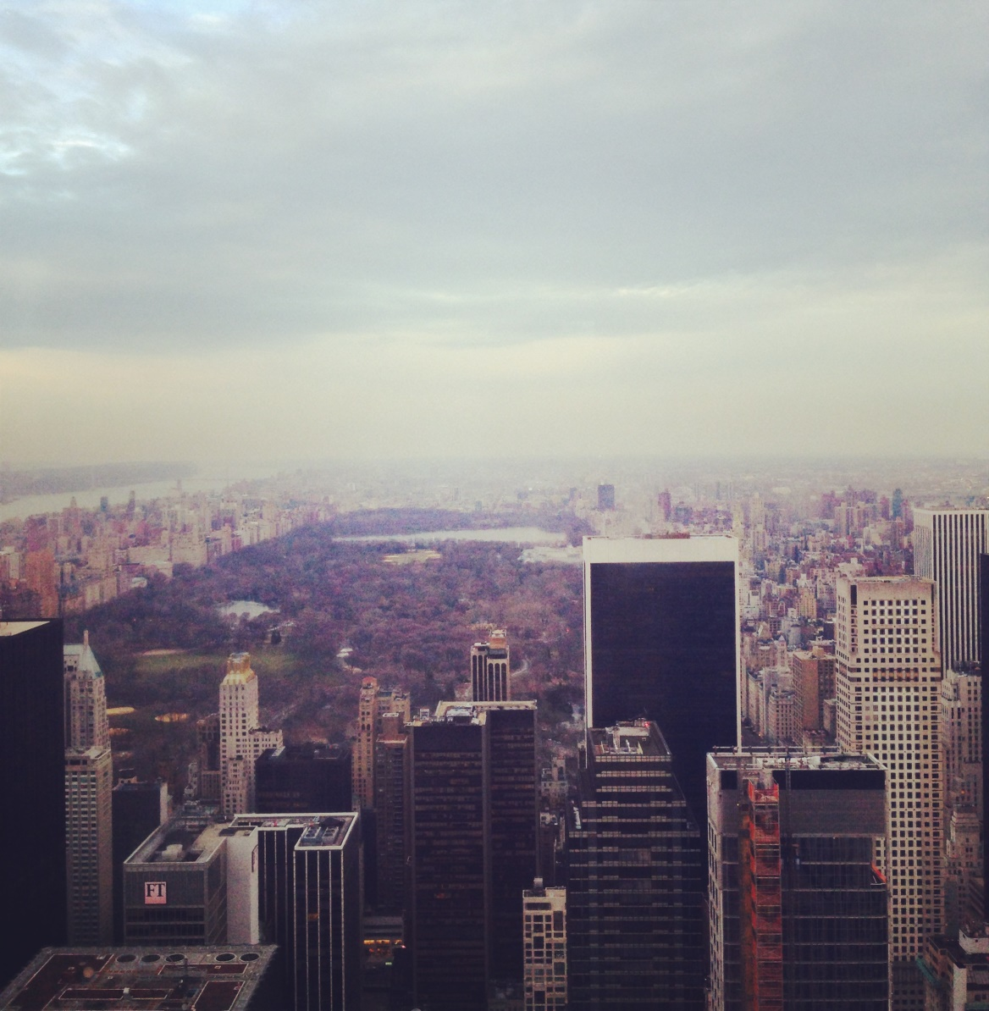
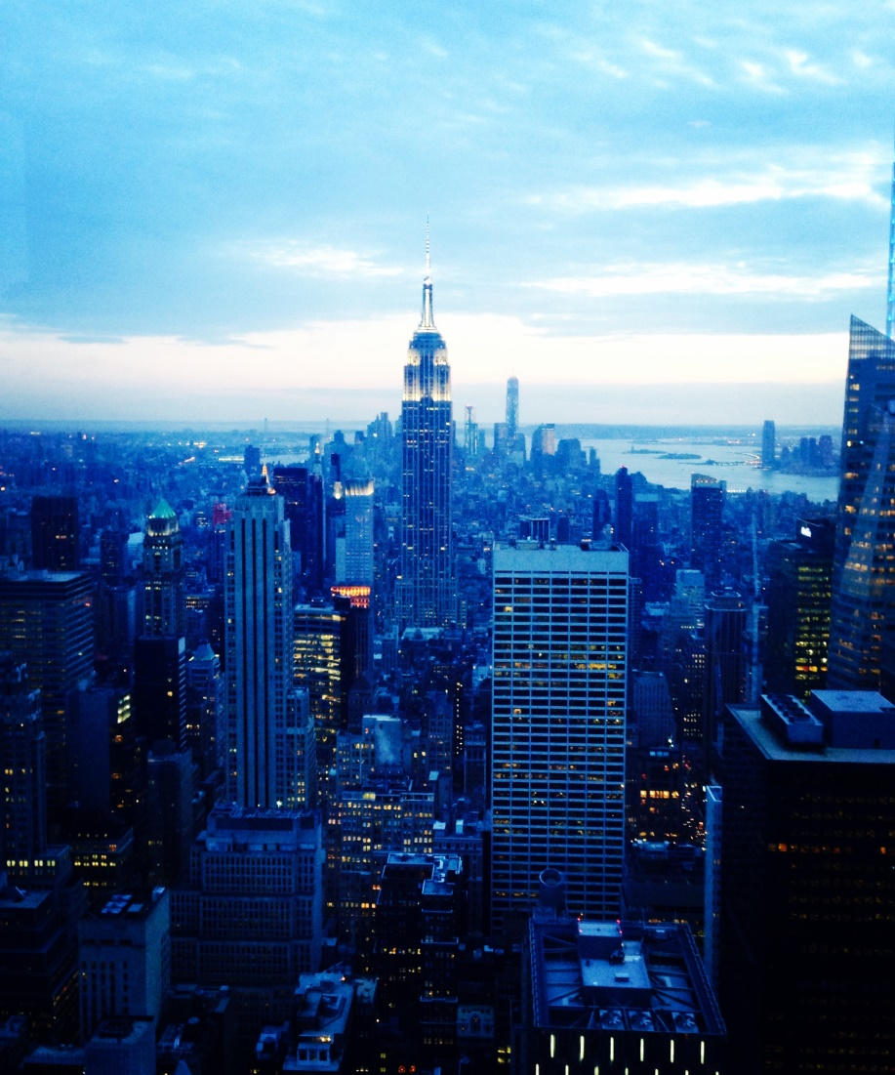
Rockfeller center
51 street and 6 avenue.

Slide 6
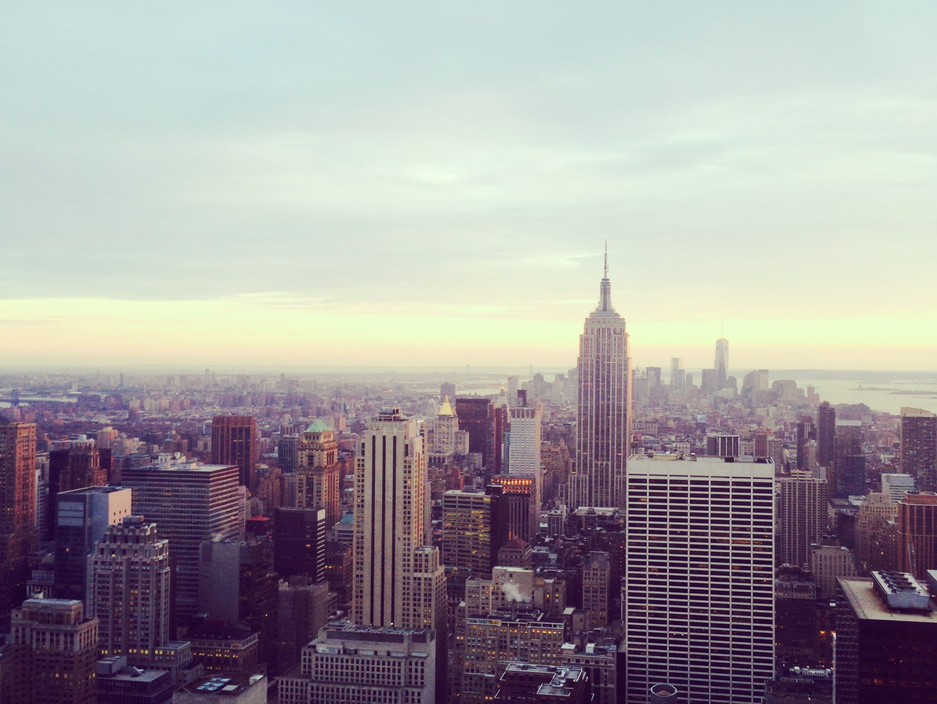

Slide 7
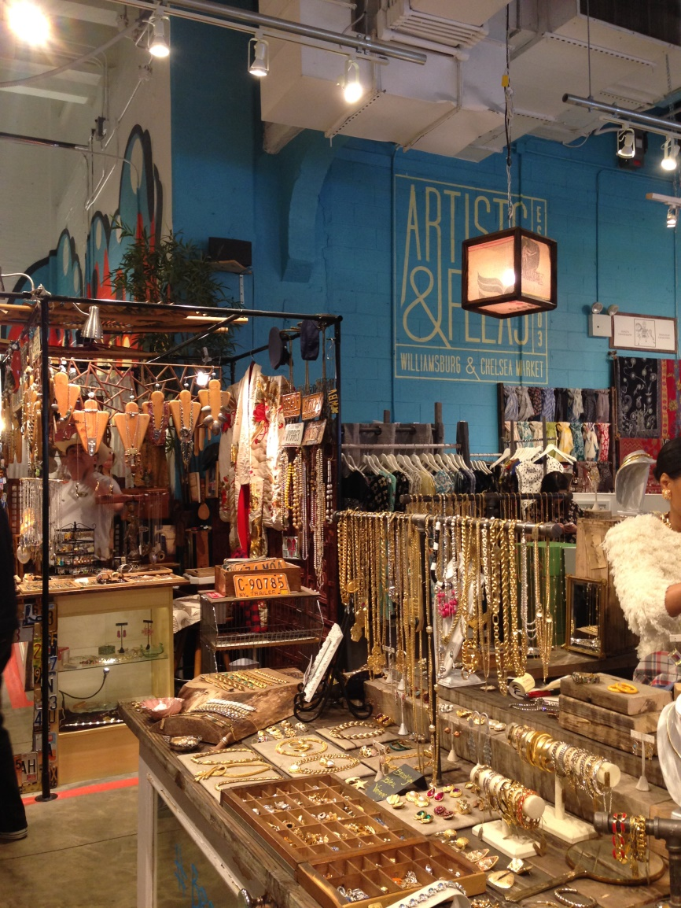
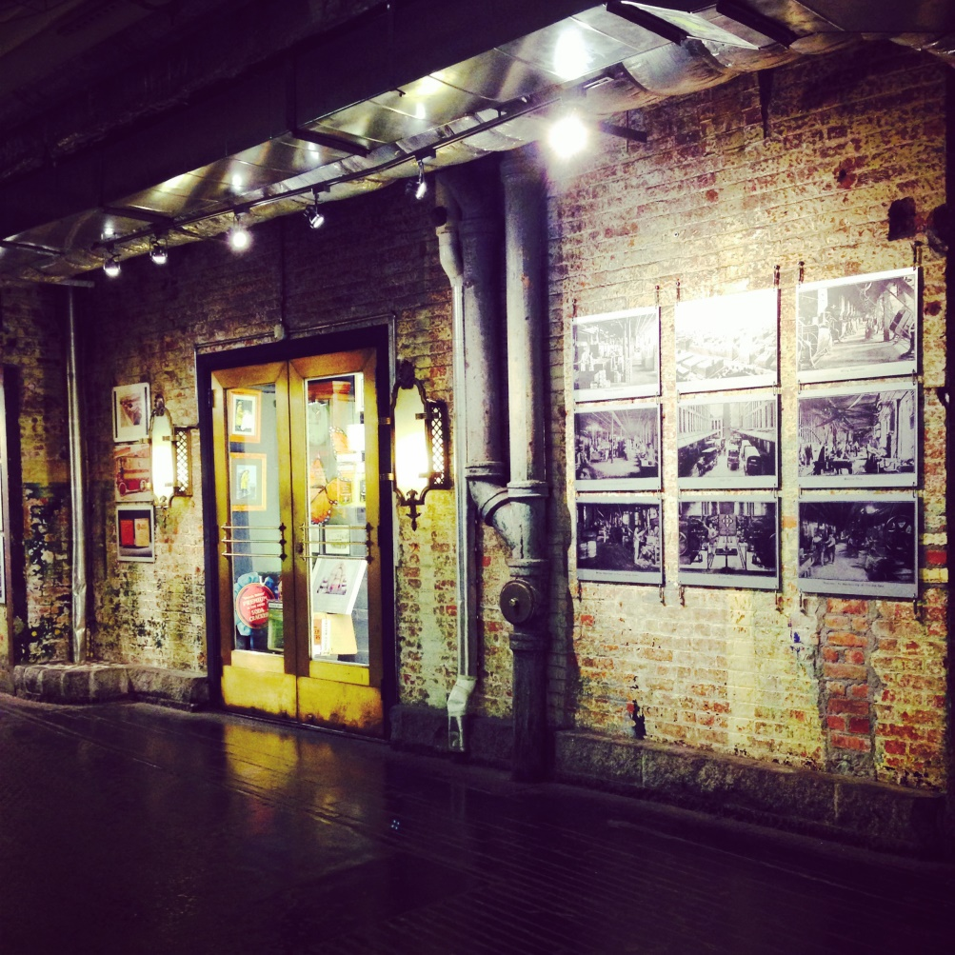
Chealsea market
Get off at 14 street.

Slide 8
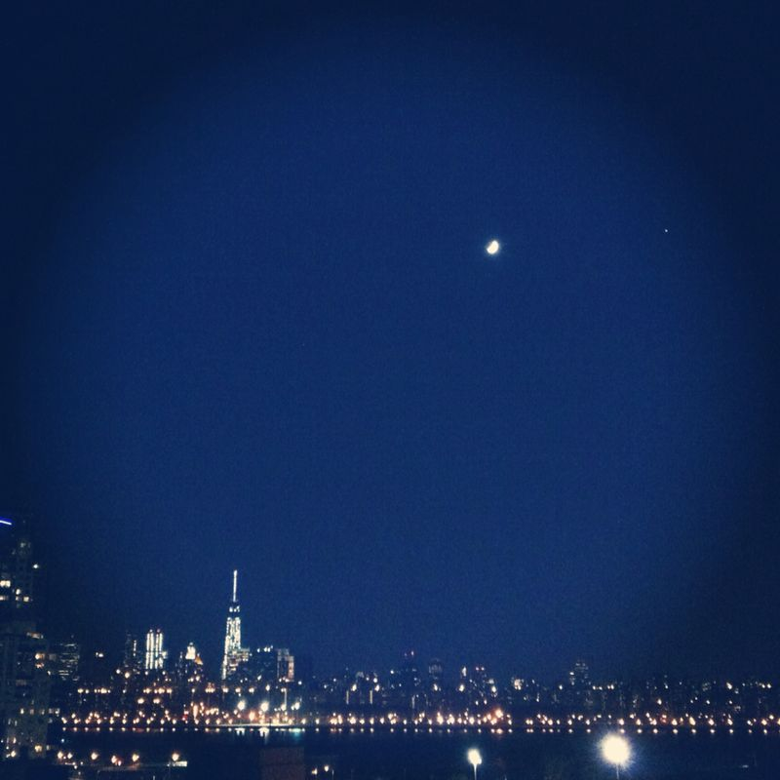
Brooklyn, Williamsburg
Subway Grey line.

Slide 9
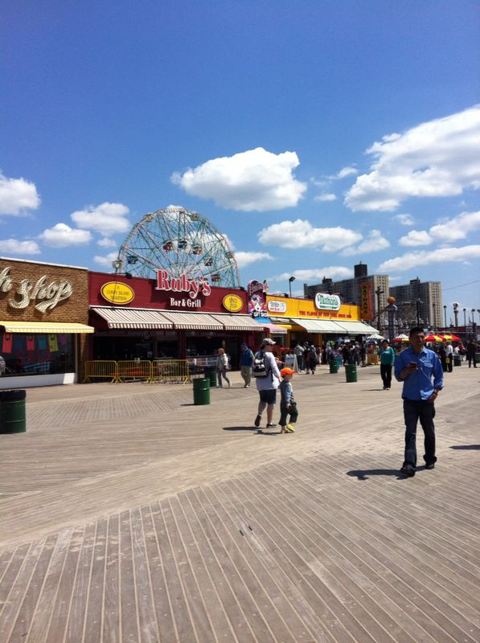
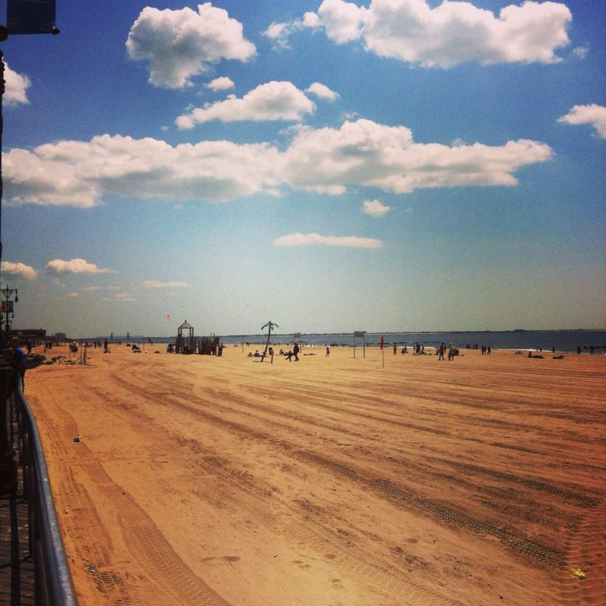
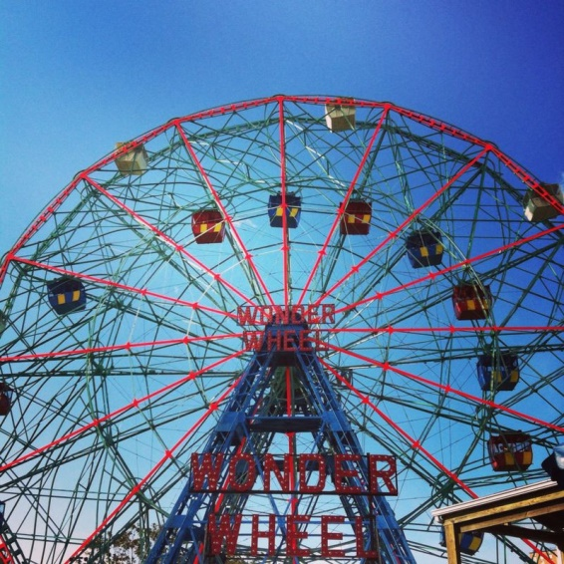
Coney Island

Slide 10
Thanks guys ☺
ENJOY in NYC
Melissa

