Slide 1
A Daytrip to Mitsuwa!
By Andras Molnar

Slide 2
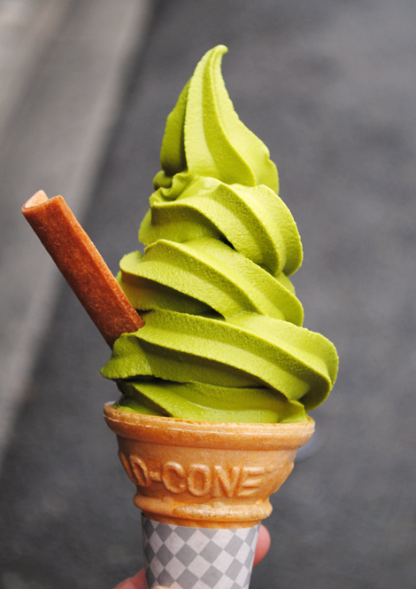
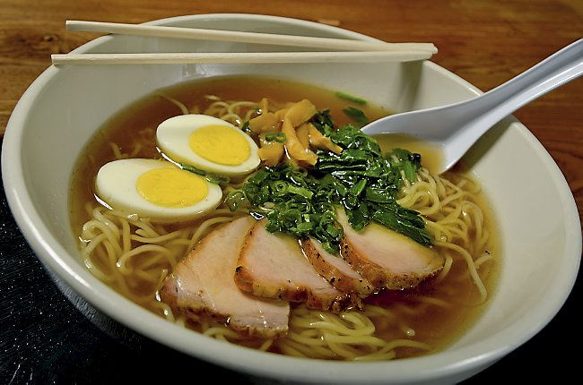
Do you like Japanese food?
Gyoza
katsu-don
Ramen
Green tea ice cream

Slide 3
Go to Mitsuwa!

Slide 4
What’s inside?

Slide 6
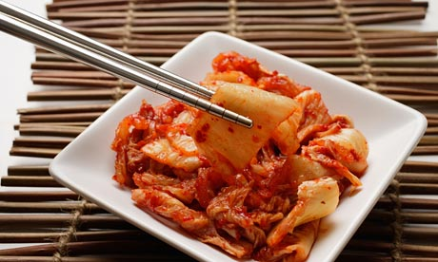

Slide 7
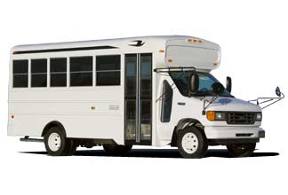
How to get there?
Take a bus from Port Authority!
(8th Ave. between 40th & 41st sts.)
It leaves from Gate #51 every hour!

Slide 8
Why go there?
Great food!
Interesting items
Japanese specialty goods
PERFORMANCE!

Slide 9
New York Taiko Aiko Kai

