Slide 1
Looking for the locations of the movies and the TV dramas
Maho Matsuura

Slide 2
Films（TVs） set in New York City
・ Sex and the city
・ Spider-man
・ Serendipity
・ Night at the Museum
・ New Year's Eve
・ The Devil Wears Prada
・ Gossip Girl
And so on ……

Slide 3
Go to the University!!

Slide 4
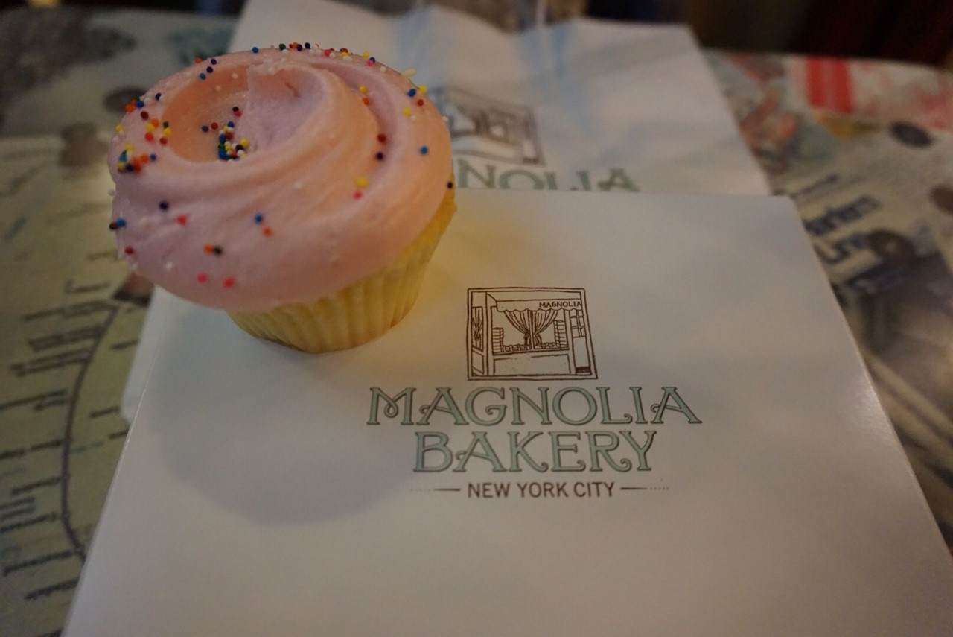
Let’s eat the cupcakes!

Slide 5
♡MAGNORIA BAKERY♡
How to get there?

Slide 6
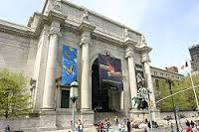
LET’ GO TO THE MUSEUM!!

Slide 7
☆American museum of natural history ☆（ＡＭＮＨ）
How to get there?

Slide 8
Ｗｈａｔ ｙｏｕ ＮＥＥＤ

Slide 9
Thank you for listening!

