Slide 1
Andras & Ruey-Ying
CEP 6.4

Slide 2
Today’s Lesson
Warm-up: Predicting Weather
Homework Check
Share Regret/Missed Opportunity
Reading Practice
Letter Writing: Formal vs Informal

Slide 3
Weather!
Discuss with your partner:
Do you watch the weather channel? How do you find out about the daily weather? Do you check at all?
How confident are you in the weather report? Do you believe what it says?
Do you know what the weather will be tomorrow?
(think about predicting)

Slide 4
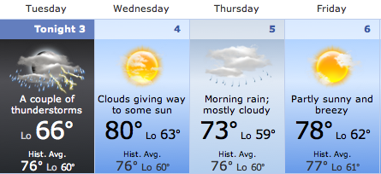
Let’s talk about the weather!
New York:
45% 10% 20%

Slide 5
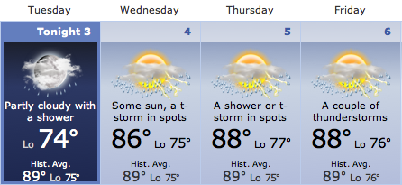
Watch your grammar!
Miami:
5% 30% 45%

Slide 6
Predictions: Present/Future vs Past
May/might/could + present tense
May/might/could +have + past participle
What are some other ways to express possibility?
I may go to the baseball.
I may will go to the basketball game.
I may have paid the bill, but I don’t remember.

Slide 7
Homework Check
Practice 4:
Possible answers:
She might have gone to the doctor’s office. She might not have wanted to come.
The delivery person might be sick. The delivery person might not have delivered it to our house.
They might have decided to go to somewhere else. They might not have wanted to spend their money.
He might have felt sick. He might not have liked the food.

Slide 8
Practice 5:
Possible answers:
It could/might have been Mike.
He could/might have gotten a promotion.
It could/might have been Tony.
I know. It must have been Gary.

Slide 9
May/might/could +not+ have+ pp
-----------------------------------------------
____________________________________
He may have gone to the movies.
He not may have gone to the movies.
He may not have gone to the movies.
He may have not gone to the movies.
He may haven’t gone to the movies.
He couldn’t have gone to the movies.
(change in meaning! This means never)

Slide 10
Share regrets/missed opportunities… also, past ability
What is the grammar pattern that expresses this?
Could + have + past participle
Could + not + have + past participle
I could have been an English teacher for SMAP!
It couldn’t have been John, he wasn’t in New York that day.
I couldn’t be in two places at the same time!

Slide 11
Formal vs Informal
When you see these words, what do you think of?

Slide 12
Let’s think about formal:
And casual:

Slide 13
Thinking about formality:
Why would you want to express formality? In what situations, with who, what is the result you expect?
Try to use predictive grammar structure How do you do this in your own culture?
Is there a difference between spoken and written.
Talk about the difference between emails and formal writing. Be aware of your tone, even with friends you use more formal language.

Slide 14
Writing p 106
Part 5:
Read the examples and choose which you think is more formal
Explain why you think this to a partner: be specific.
Part 6
Read the passage and circle the more formal answers.
https://www.youtube.com/watch?v=wTNTroENltY
Now let’s compare a formal and informal letter

Slide 15
Practice!
Write a short email to Andras and Ruey-Ying about something related to class.
Perhaps you…
cannot make it to class,
you would like to request some extra practice,
or you have a question about New York
You will have 8 minutes.

Slide 16
Be sure to include:
Dear Name
Why are you writing.
Reason.
1 or 2 supporting sentences
(Use linking words)
(No contractions)
Thank you …
Sincerely,
Full name

