Slide 1
Andras & Ruey-Ying

Slide 2
Today’s Lesson
Pyramid Listening Activity
Review Unit Test 9
Listening and Reading Practice
Share the mysteries you researched

Slide 3
Revisiting one of the mysteries from yesterday...

Slide 4
Listen and fill in the blanks (p.97)
Read the paragraph and try to predict what kinds of words the answers could be.
Listen and write down the correct words.
Did you correctly predict the answers?
Listen again. Check the answers with your group.

Slide 5
Exercise 2
1. 750
2. Scotland
3. monster
4. dinosaur
5. lake
6. 1,500
7. 1980s
8. photographs

Slide 6
Another mystery...
Nazca Lines

Slide 7
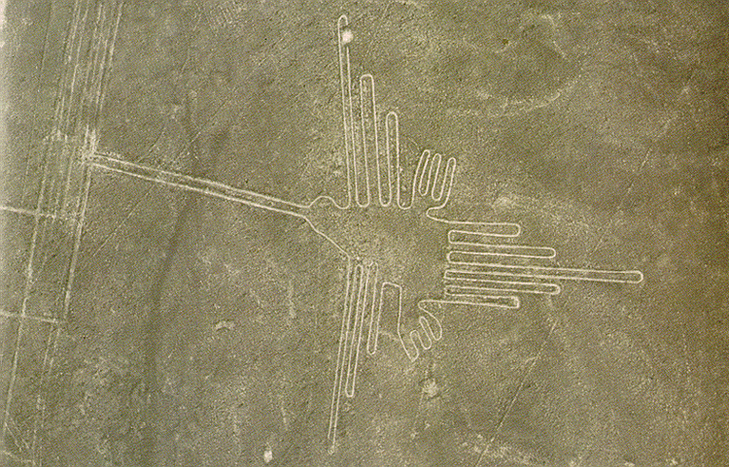
What do you think this is?
This may be a...
This might be a...
This could be a...

Slide 8
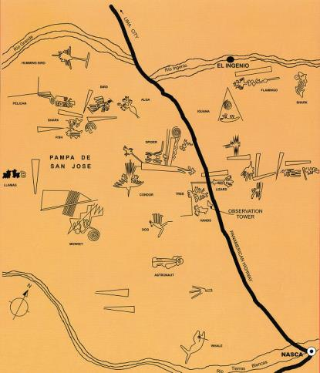
Nazca Lines
Who built it?
It might have been...
What was the purpose?
It might have been...
Share with your group!

Slide 9
Figure it out (p.98)
Read the conversation on p. 98 and do the vocabulary check.
f, e, g, a, b, d, c

Slide 10
According to the conversation...
What do the drawings show?
Who may have carved the drawings into the ground?
What could be the purpose of the drawings?

Slide 11
Spontaneous Combustion!
https://www.youtube.com/watch?v=BP9j4YQlzp0

Slide 12
Spontaneous Combustion!
What was the name they called Spontaneous Combustion in the clip?
Where was the man when he caught fire?
Did he know he caught fire?
Was anything burned?
Did he live?
TRY TO CATCH: what some of the theories are

Slide 13
Grammar (p 99) Answers
**Since the official chance to how likely the event happened is not listed, this is all opinion and guessing.
1. might/may/could have existed
2. might/may/could have disappeared
3. might/may/could have survived
4. might/may/could have come
5. might/may/could have been
6. might not/may not have expressed
7. might/may/could have drawn

Slide 14
Part 2
Here are some possible answers:
1. Someone might/may/could have spilled tea on it.
2. The previous owner of the house might/may/could have been trying to communicate with us.
3. They might/may/could have won the money in a lottery.
4. She might/may/could have taken the bus.
5. (Dan) might/may/could have told them where he was.
6. He might/may/could have gone on vacation.

Slide 15
Where are my keys!? ☹

Slide 16
I lost my wallet! Where could I have lost it?
It’s 2pm. You are at a grocery shop and ready to pay for your groceries. You just realize that you lost your wallet!
Work with your partner. Use the schedule to find out where your partner lost his/ her wallet.
The symbol ★ indicates where you lost your wallet.

Slide 17
Example
A: You may have lost your wallet when you walk from the subway station to TC this morning.
B: No, I did not lose my wallet on my way to TC. I still had my wallet when I was in class this morning.
A: You might have lost your wallet in the TC dining hall when you had lunch today.
B: Yes, I could have lost my wallet there.

