Slide 1
Ayako | Jesus
Nasser | Noriko
Melissa | Masayo
Carolina | Sawako
Makoto | Alejandra
Danilo | Mami
Yuka | Maho

Slide 2
CEP 6.19, Unit 12: Wishful Thinking
Andras & Ruey-Ying

Slide 3
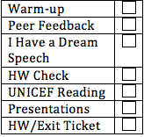
Today’s Lesson
Warm-up
Peer Feedback
I Have a Dream Speech
HW Check
UNICEF Reading
Presentations: Melissa and Ayako
HW/Exit Ticket

Slide 4
Warm-Up
Revisiting pronunciation:
Usually two content words together like:
Fun time
Blue shoes
Will have the stress on the 2nd word.

Slide 5
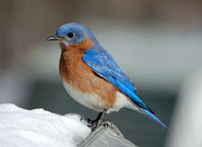
But..
However, there are exceptions.
Think back to:
The White House
bluebird vs a blue bird
waterfall
What do you notice?

Slide 6
What about for emphasis?
I want the red cap. I don’t want the BLUE cap.
That is the one CRAZY man.
Challenge: Oh man, that is the worst cupcake I have ever eaten.
Stress: Oh MAN, THAT is the WORST CUPcake I have EVER eaten!

Slide 7
Take Away
Often, in a adj + noun or noun + noun combo, the second of the two words are stressed.
There are 3 possible exceptions:
A name (White House)
Compound word (bluebird, drugstore)
For emphasis (wow, that is a NICE hat)

Slide 8
Take a look at WB p 92
Follow the directions in the book:
Underline the adj + noun and noun + noun combos
After that, mark with a * which word you think will be stressed.
Listen and compare your predictions.

Slide 9
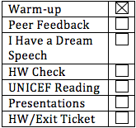
Peer Feedback
Take out your peer review form. Take 1 minute to review what you wrote.
Peer conference
Reviewer: go through every item on the peer review form. Explain why you wrote what you wrote and give examples.
Writer: ask for clarification if there is anything you don’t understand/ you don’t agree with

Slide 10
Round 1 (5 mins):
Choose who will be the reviewer
Share feedback
Round 2 (5 mins):
Feedback for the other person

Slide 11
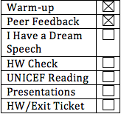
I Have A Dream
Who is this?
What did he do?

Slide 12
Martin Luther King Jr.
Lived from 1929 – 1968
His famous “I Have a Dream” speech
August 28, 1963
Let’s take a look at the speech!
Read the segment of the speech while listening to the clip.

Slide 13
I Have a Dream speech

Slide 14
What was the significance of the speech?
Discuss in pairs.
What was his wish?
Did he wish for changes to the past/ the present/ the future?
Underline “I have a dream” and try to catch it in the video. We will watch it again.

Slide 15
Modify the Speech
Look at the sentences expressing Martin Luther King’s future wishes, and change the structure to the I wish structure.
Wishing for changes to the future:
I wish someone/something + would/could + verb.

Slide 16
Examples
Speech: I have a dream that one day this nation will rise up and live out the true meaning of its creed.
Wish: I wish this nation would rise up and live out the true meaning of its creed.
Speech: With this faith, we will be able to hew out of the mountain of despair a stone of hope.
Wish: I wish we would be able to hew out of the mountain of despair a stone of hope.

Slide 17
Complete the Worksheet
Work in pairs to modify the sentences.
I wish someone/something + would/could + verb.
You don’t have to rewrite the whole sentence!! Just underline and change the part you need.
Table 1: start with #1-#3
Table 2: start with #4-#6
Table 3: start with #7-#9
If you have time, continue doing the rest of the worksheet.
Notes:
Speech:
http://www.americanrhetoric.com/speeches/mlkihaveadream.htm

Slide 18
Share your sentences with the pair across table.

Slide 19
Answers
I wish (the state of) Mississippi would be transformed into an oasis of freedom and justice.
I wish rough places would be made plain, and that crooked places would be made straight.
I wish everyone would be able to join hands and sing…
I wish the glory of the Lord would be revealed and all flesh shall see it together.
I wish everyone would join hands one day.
I wish this day would be the day when all God’s children sing with new meaning.
I wish every valley would be exalted and every hill would be made low.
(same as 6)
I wish we would be able to work, pray… and stand up for freedom together.

Slide 20
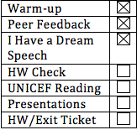
HW Check
What are some of the sentences you made?
Deforestation:
Situation: The forests are getting chopped down
Grammar: I wish the forests would not get cut down because then the animals will have nowhere to live.

Slide 21
Wishing for Future Change
I wish + somebody/something+
could/would + base form of verb
Quiz:
I wish we ________ reduce the amount of pollution.
I wish the government _________ do something about the problem.
I wish factories _________ find cleaner ways to make products.
could
would
would

Slide 22
Practice: what is the wish? (use we)

Slide 23
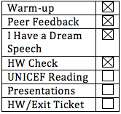
Reading
What are some organizations that have been formed to help improve the world?
Intergovernmental organization
Finance: World Bank
Trade: WTO
Health: WHO
Non-governmental organization
Environment: Greenpeace
Humanitarian: Red cross

Slide 24
UNICEF: Working for a better world
Let’s read the first paragraph of the article (line 1-9).
What type of issue does UNICEF focus on?
Who founded UNICEF?
What was the original purpose of UNICEF?

Slide 25
Read the article
Count off 1’s and 2’s.
1: Read the 2nd paragraph (line 10-21)
2: Read the 3rd paragraph (line 22-25)

Slide 26
Create an outline (again...)
Look at practice 3: outline chart
I. Origin of UNICEF
A:1946
B:provide food and supplies to children needing help after WWII.

Slide 27
1: Complete II.
2: Complete III.
Wait! The outline needs to be changed:
III. ____________________
A. Voluntary contributions
B. _______________
1. _________
2. _________
3. _________

Slide 28
Exchange your outline with your partner.
Check your partner’s outline. Does it accurately summarize the paragraph?
Discuss with your partner.

Slide 29
Answers
II. A. 2: supports projects that help reduce infant mortality rates
II. A. 3: provides emergency relief following disasters, wars or epidemics
II. B. 1: provides funds for training nurses, teachers, and child welfare specialist
II. B.2: sponsors classes in nutrition, child care, parenting, and basic education

Slide 30
III. Sources of Support for UNICEF
III. B. Other funds
III. B. 1: Sale of greeting cards
III. B. 2: Television benefits hosted by famous personalities
III. B. 3: Other types of fund-raising activities supported by private citizens.

Slide 31
Vocab
Group the words with similar meanings:
focus(8) | goals(11) | support(16)
benefit (8) | equipment(14) | sponsor(24)
aid (10) | supplies(14) | contribute (26)

Slide 32
aid, benefit, support, sponsor, contribute
help, provide (services/ fund), etc.
goal, focus
objectives, purpose, etc.
supplies, equipment
resource, appliance, etc.
Use different words to express similar meanings in your writing!

Slide 33
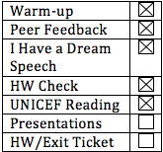
Presentations
Today’s presenters:
Melissa
Ayako

Slide 34
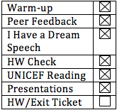
HW/Exit Ticket
HW…

Slide 35
Have a great weekend!!

