Slide 1
Unit 12: Wishful Thinking 6.17

Slide 2
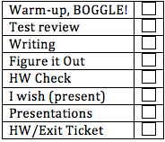
Today’s Lesson
Warm-up, BOGGLE!
Test review
Writing
Figure it Out
HW Check
I wish (present)
Presentations (Mami, Yuka, Noriko)
HW/Exit Ticket

Slide 3
Boggle
Let’s play!

Slide 4
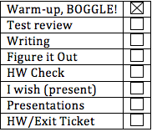
Test Review
Class Average….
…..
…..
91.3%!!

Slide 5
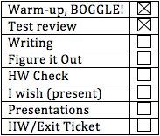
Writing:Persuasive letter
What is a formal persuasive letter?
Persuasive paragraph+ formal letter!
What might be some reasons to write a letter to persuade people in a formal way?
Join an organization
Donate money to an organization/event
Vote for a particular person
Change current policy of a particular issue
...etc.

Slide 6
Structure of persuasive letter
What are the important parts of a formal letter?
Dear Name
Why you are writing
Reason
Thank you …
Sincerely, + full name
What is the structure of a persuasive argument?
Your point of view
Reason (+ supporting details)
Conclusion
Combine them together!

Slide 7
Look at the outline
State your purpose and your point of view
I am writing to ask you to support...
I would like to express my concern about...
Reason + Supporting examples
Use linking words! (First, Second, Finally, etc.)
Final comments
Please feel free to contact me if you have any questions.
I look forward to...
Call to action (look at the example!)

Slide 8
Example
Look at the recipient on the top of the letter.
Who is the recipient?
Read the paragraph [1]
What’s the purpose of this letter?
What might be the reasons to support his point of view?
Read the paragraph [2]
What might the content of the last paragraph?
Read the paragraph [3]
What is “call to action”?
Let’s create an outline!

Slide 9
Create an outline
Textbook p.126:
A large company is planning to donate $5 million to the arts and is looking for worthy recipients.
You are writing for an art organization in N YC (e.g. SVA, MoMA PS1, NYC Ballet) in order to get the donation.
Use the chart to brainstorm some reasons why you think the organization should get the money.

Slide 10
HW
Write a persuasive letter based on the outline you created.
We are going to do peer review, so please upload your letter to dropbox by 7AM tomorrow! (or bring a hard copy to class tomorrow)

Slide 11
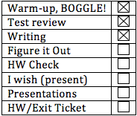
Figure It Out
Read the directions.
What is a millennium… what is the 3rd millennium?
We are in the _____ century
What are some problems in the 21st century?

Slide 12
Directions
Read dialogue 1
Answer the questions with a partner:
What is Alfred’s wish?
What specific example does Alfred mention?
Who disagrees with Alfred? What is said?

Slide 13
Read dialogue 2
Answer the questions with a partner:
What is Justine concerned about?
Which speakers are idealists (in dialogues 1 & 2)?

Slide 14
Vocab Check!
Let’s try a different way:
With your partner, cover the answers on the right side with your hand
Try to come up with different words for 1 -10 without looking. (3 mins)
Now try to match.
This is a good test strategy!

Slide 15
Check your understanding p 119 #1
First read the example sentences in the box
Let’s look at this section.

Slide 16
HW Check
Check with your partner
Were
Didn’t have
Didn’t need
Had
Could
Had
Could

Slide 17
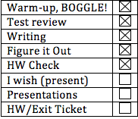
Grammar Point: I wish (present)
First: What is the difference between a HOPE and a WISH?
Wish = used in imaginary situations
I wish I had a million dollars!
Hope = desired outcome, more possible
I hope this works!
I hope I get an A on the test!
Can you think of an example of each?

Slide 18
Wishing in the present
I/you/he/she/we/they + wish(es) +
something/someone + past tense
They wish Amazon had more trees.
I wish people cared more about the environment.
I/you/he/she/we/they + wish(es) +
something/someone + were
She wishes she were taller.
He wishes he wasn’t fat.

Slide 19
Wishing in the present
I/you/he/she/we/they + wish(es) +
something/someone + could/were able to
I wish I were able to fly.
They wish they could win the lottery.
Wait!!
I wish I didn’t have a flat tire.
I wish I didn’t like chocolate so much, I can’t stop eating it!!

Slide 20
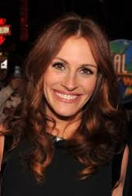
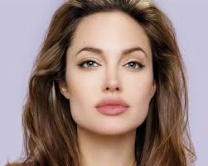
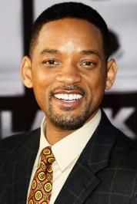
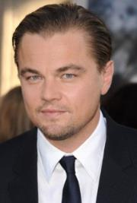
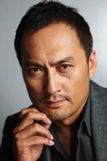
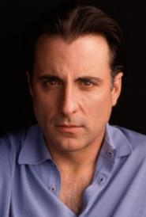
I wish…

Slide 21
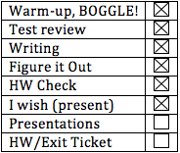
Presentations
Mami
Yuka
Noriko

Slide 22
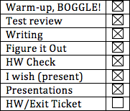
HW for 6.18
Textbook:
Wishing for changes to the past : Practice 4 (p.120-p.121). Write down the sentences you create based on the prompts.
Write a persuasive letter:
Refer to the outline. Make sure you have all the parts of a formal letter.
Use linking words between and within sentences.
Upload your letter to dropbox by 7AM tomorrow (or bring a hard copy to class tomorrow).
Presentation tomorrow: Alejandra, Maho, Masayo

