Slide 1
Boggle!!

Slide 2
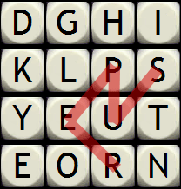
Some possible words:
Super
Hips
Run
Stun
Push
Ship
Key

Slide 3
Rules:
You will have 3 minutes
The words must be at least three letters long
The boxes must be connected
You cannot use the same letter twice in one word.

Slide 4
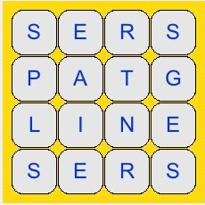

Slide 5
