Slide 1
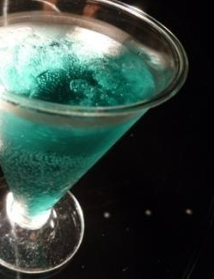
Bar, Cafe
in NY
Ayako

Slide 2
PDT

Slide 3
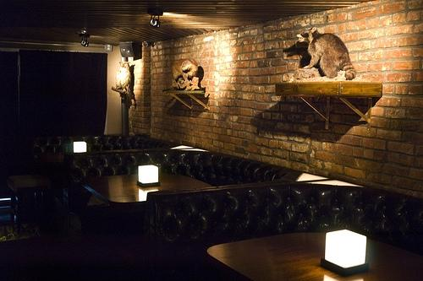
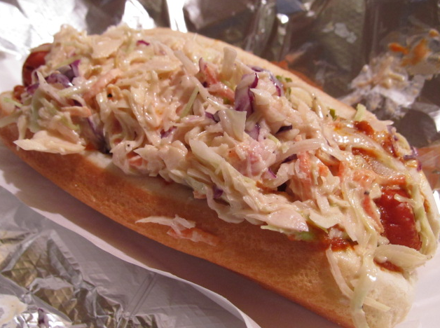
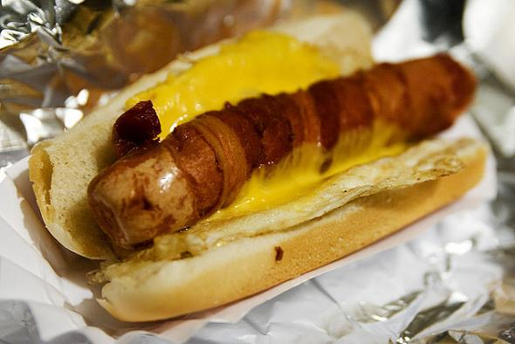
PDT - Please Don’t Tell
This is only small bar.
- Why?
history
the bartender
hotdog
-When I went the bar, I had to wait for 3 hours.

Slide 4
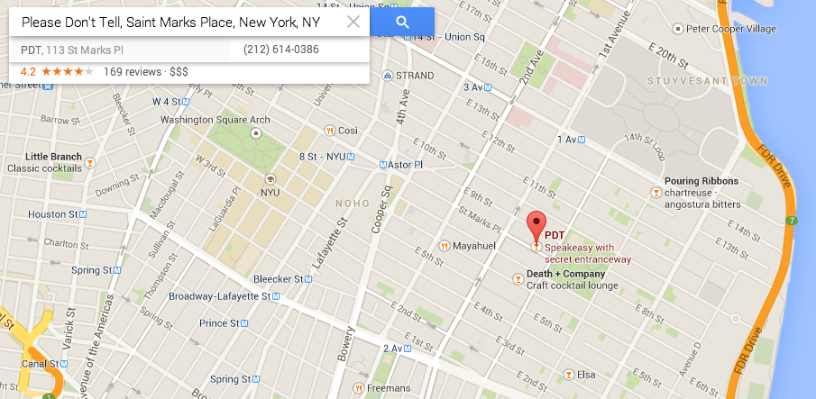
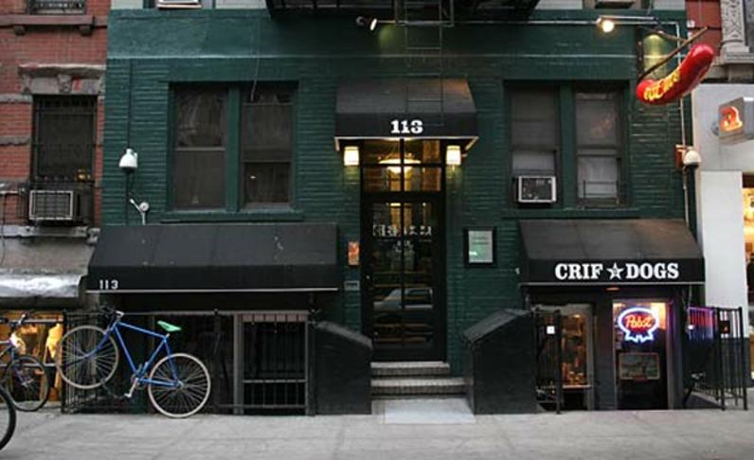
Access - It’s difficult !!

Slide 5
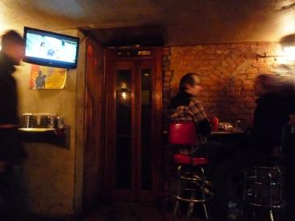
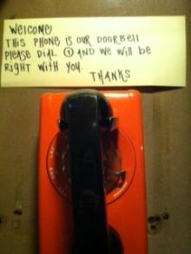
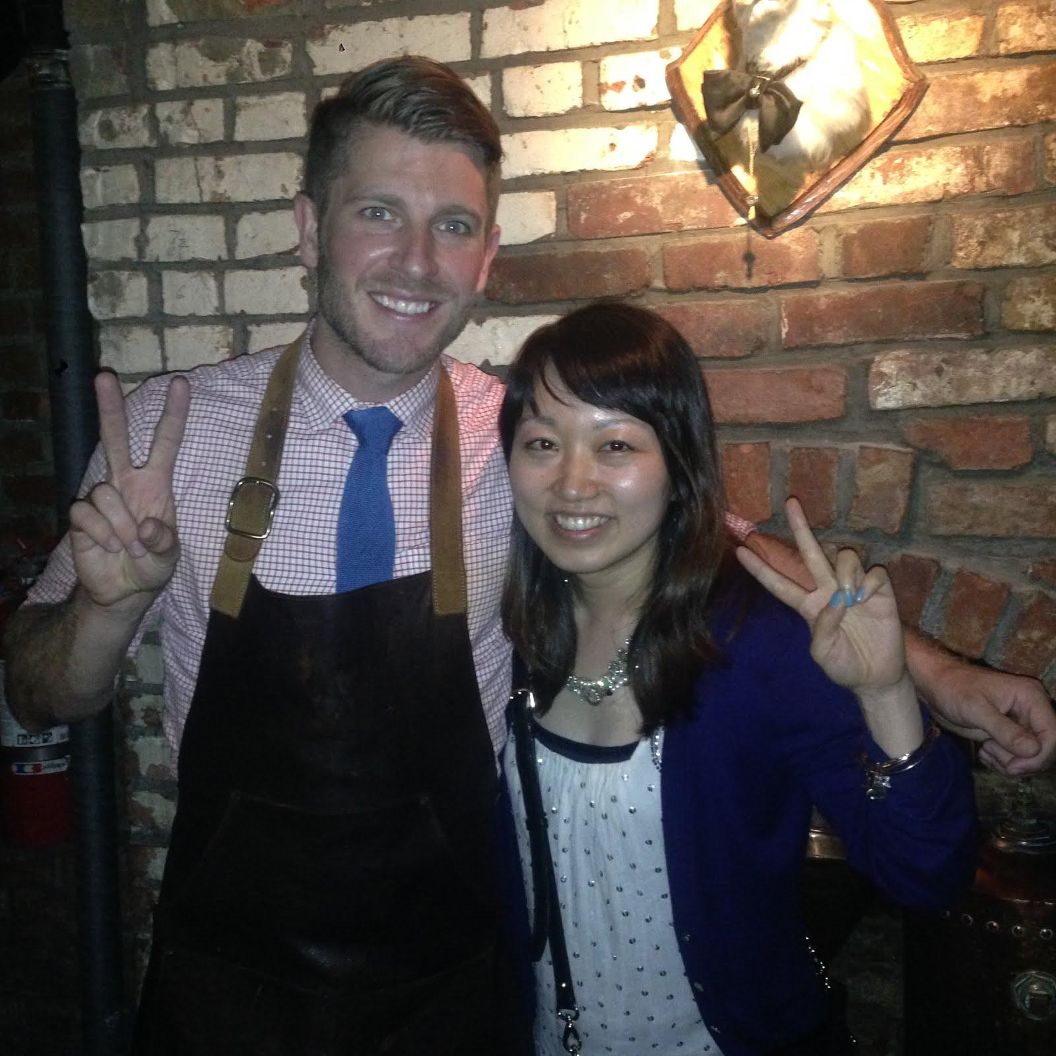
Access
inside restaurant
no sign
no door
need phone

Slide 6
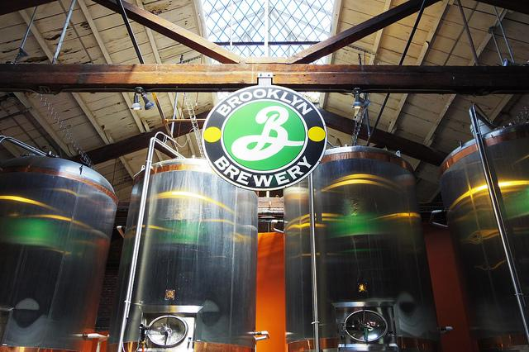
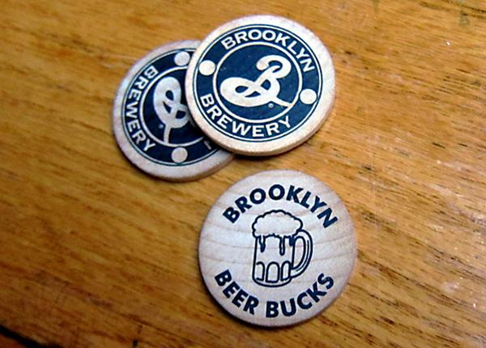
Brooklyn Brewery in Williamsburg
only weekend
factory tour
different beers
many goods, special beer.

Slide 7
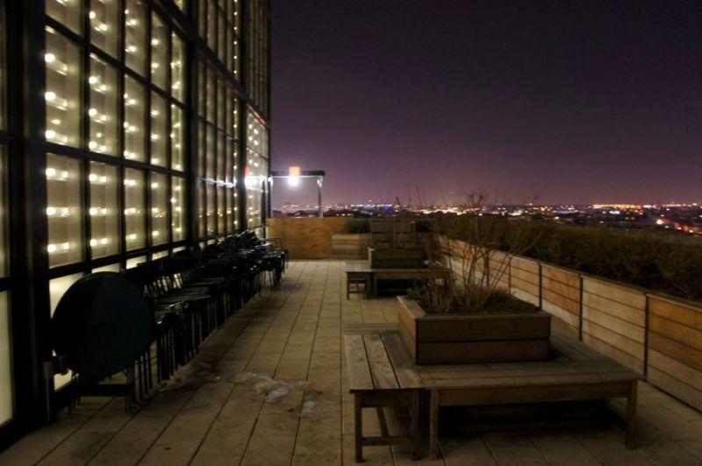
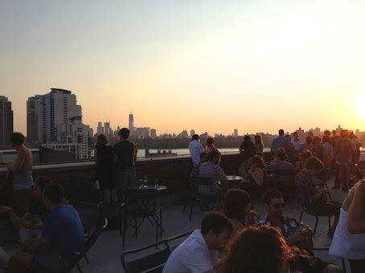
Rooftop Bar (the Ideas in Wythe Hotel)
Don’t need to stay the hotel
View is so beautiful

Slide 8
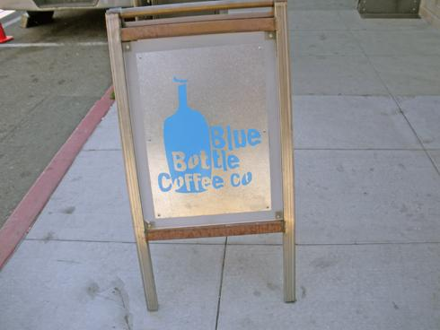
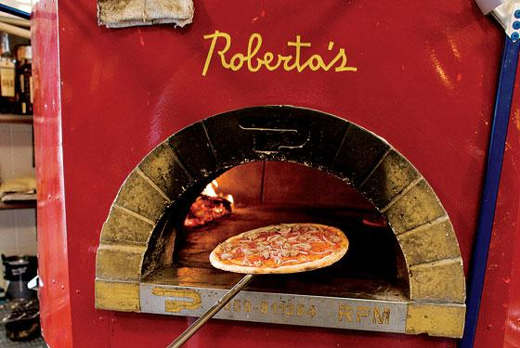
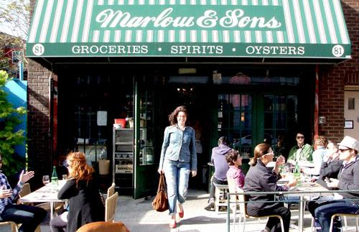
Appendix
Blue bottle coffee
Roberta’s
Swallow Cafe
blue note, small etc (Jazz bar)
Jacques (moules with beer)
Mermaid Inn ( oyster, lobster with beer)

