Slide 1
Grand Central Terminal
It is very exciting place!!
06/12/2014
Sawako Shimanouchi
1

Slide 2
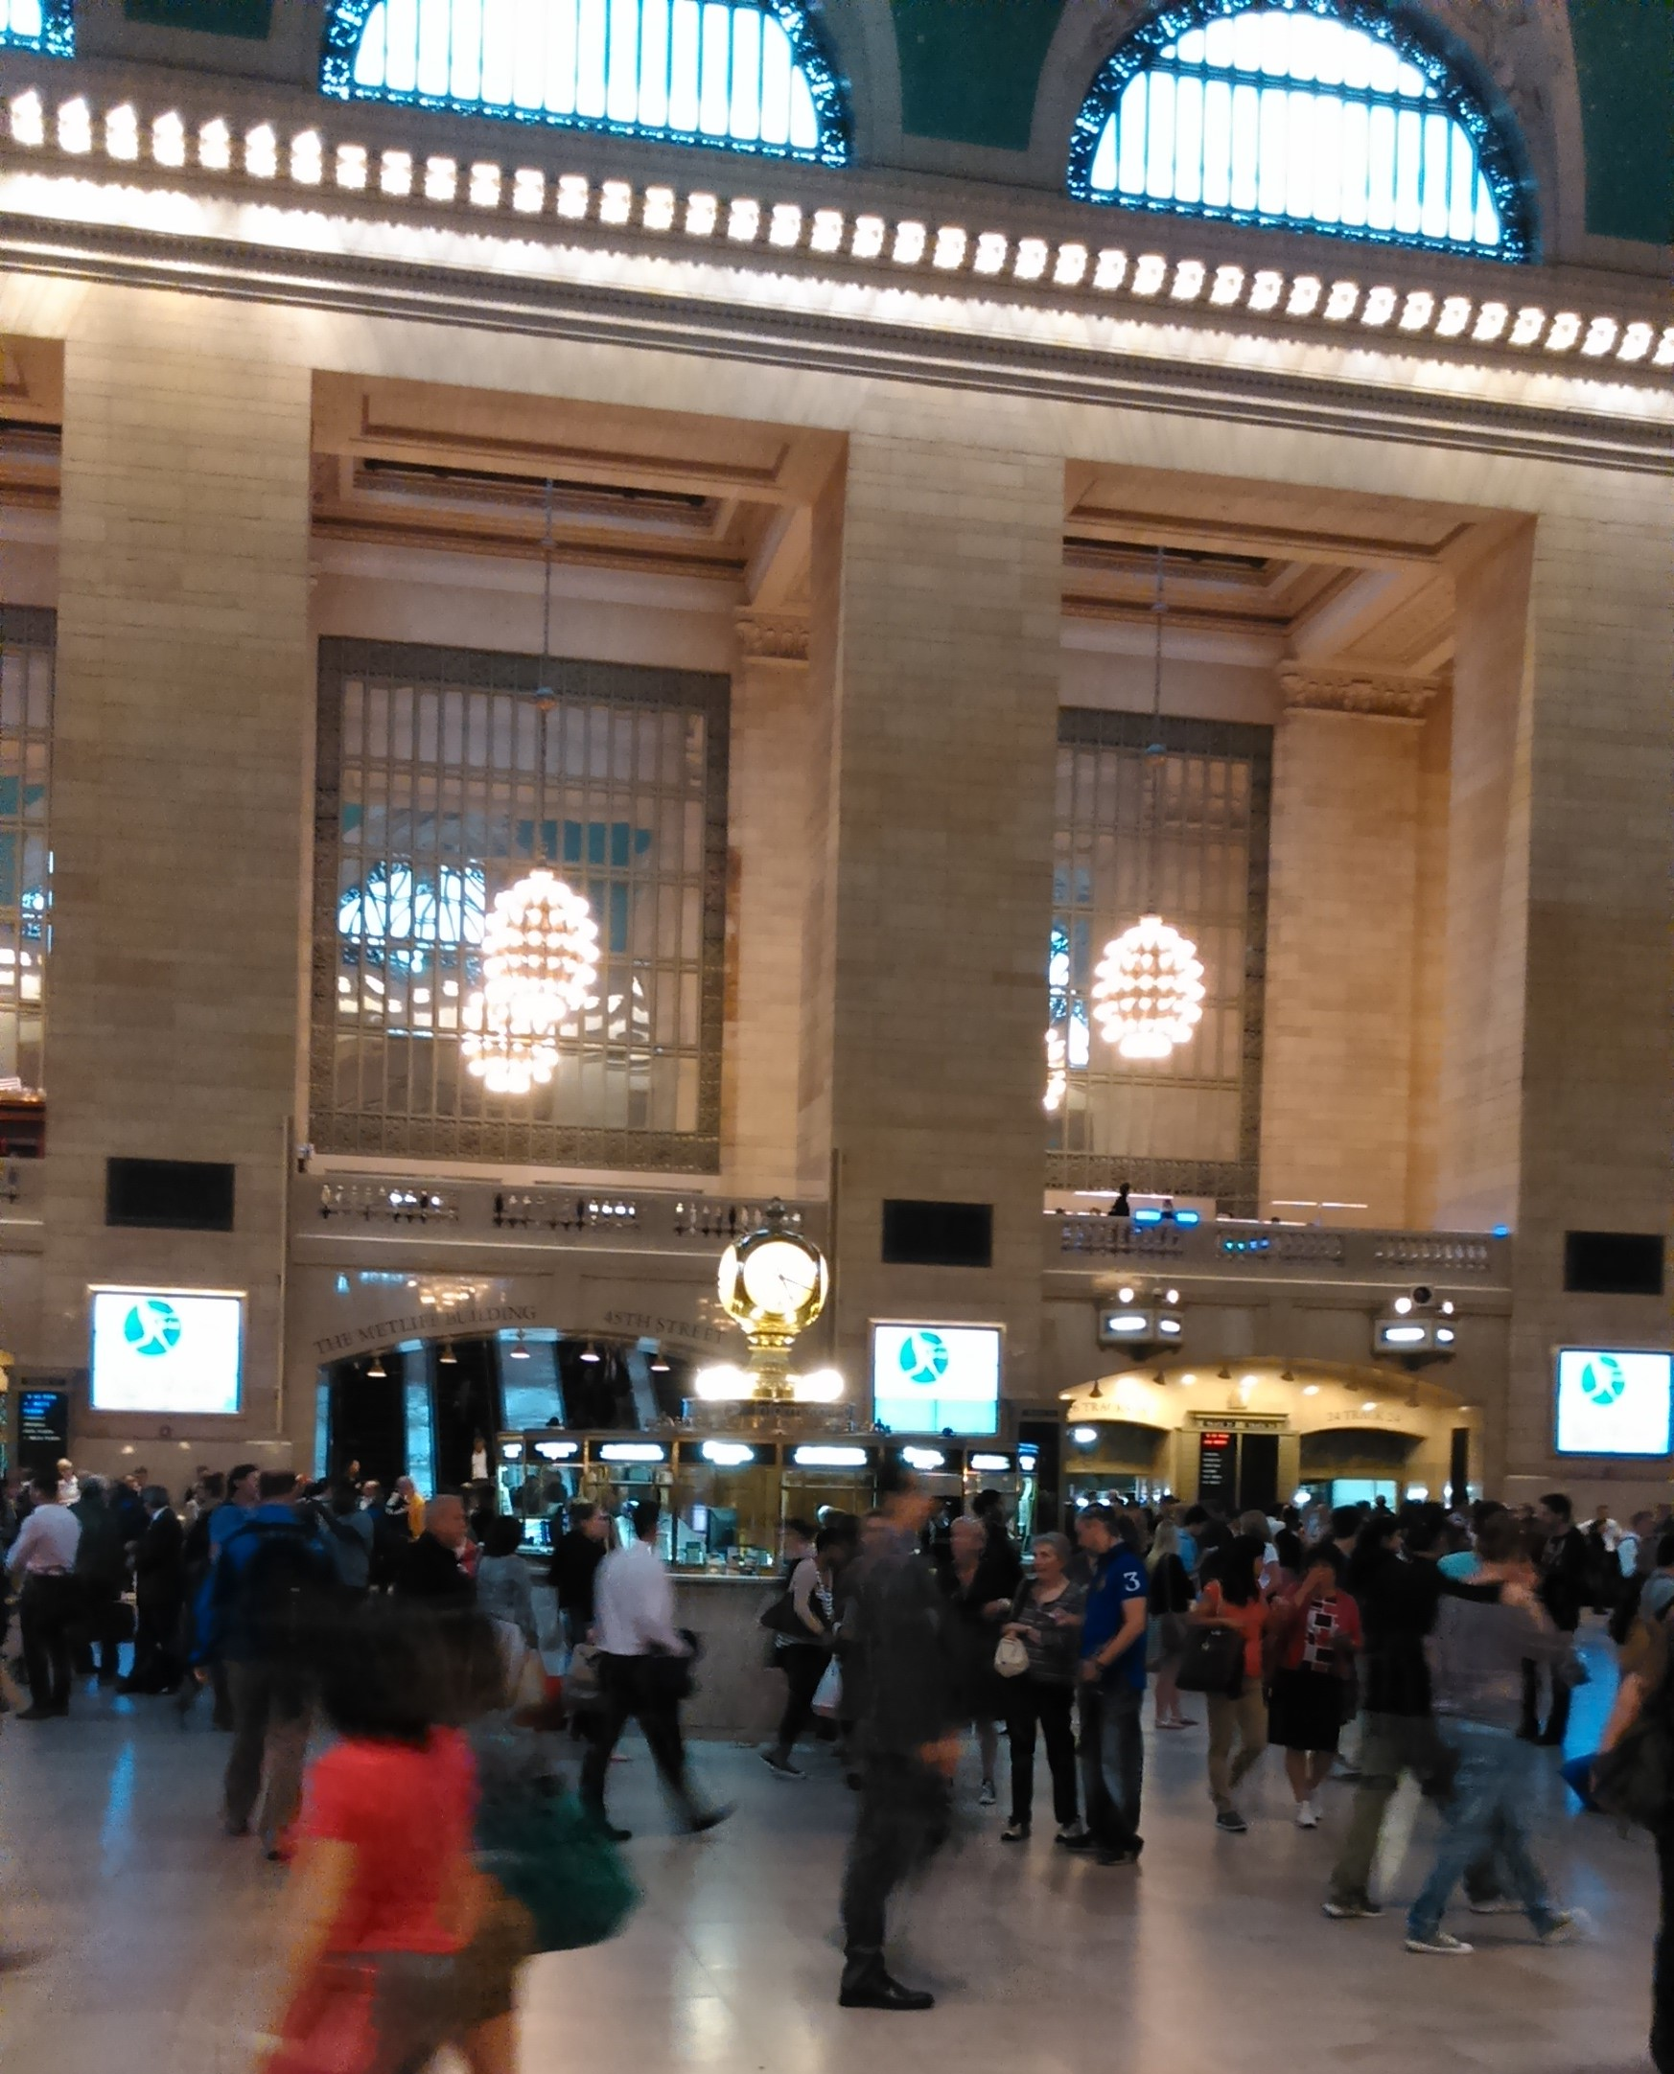
A landmark architecture in New York
Terminal station of metro north rail road
The biggest terminal in Manhattan.
44 platforms and 67 tracks.
120,000 people per a day use

Slide 3
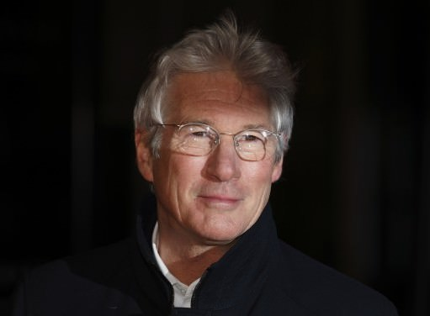
Do you know this topic?
‘Only one person, French tourist Karine Gombeau, offers Gere a bag of food, without knowing it’s the Golden Globe-winning actor. Gere happily took the bag and thanked the woman.’―”New York Post”
3

Slide 4
GCT is a shopping mall.
53 shops and 35 dining
In dining concourse you can eat popular foods in New York.
4

Slide 5
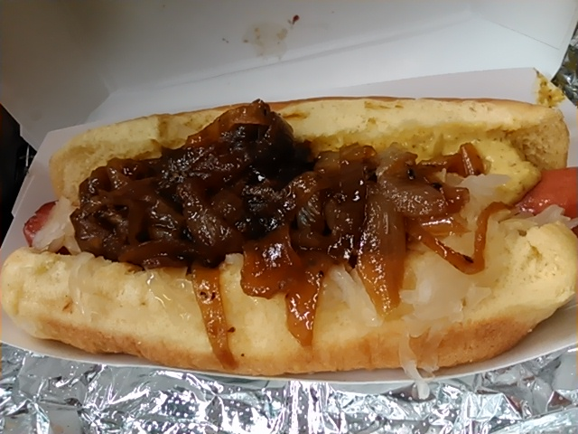
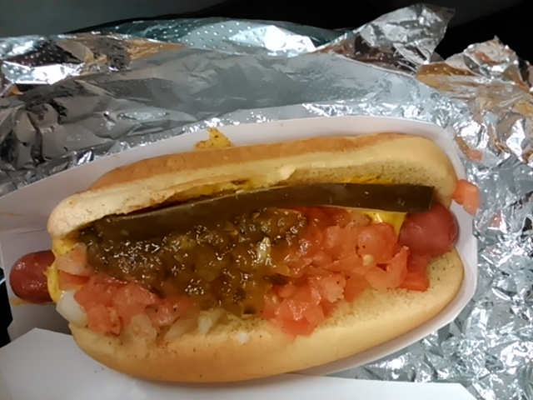
New York Hot Dog
Which Pronunciation? “Sicago?” or”Ticago?”
boiled onion
Tamato
New York
Chicago dog
5

Slide 6
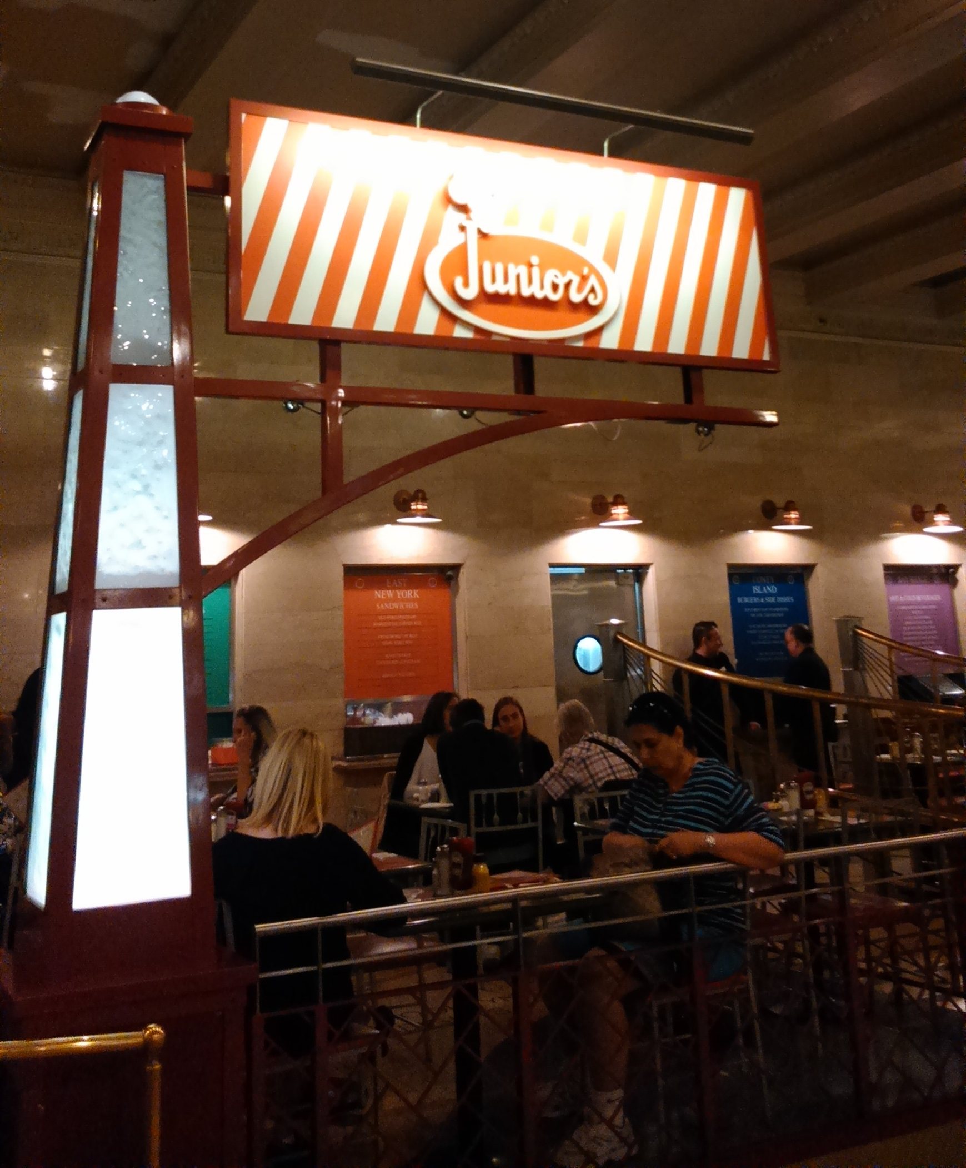
New York-style cheese cake
Smooth!!
Strong taste of cheese!!
6

Slide 7
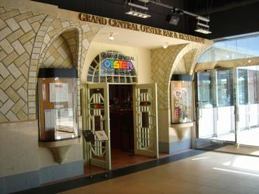
Oyster bar restaurant
Tokyo
New York
7

Slide 8
Thank you very much.
Let’s enjoy GCT!!
8

