Slide 1
San Antonio Bakery and Puro Wine
Carolina Espinoza

Slide 2
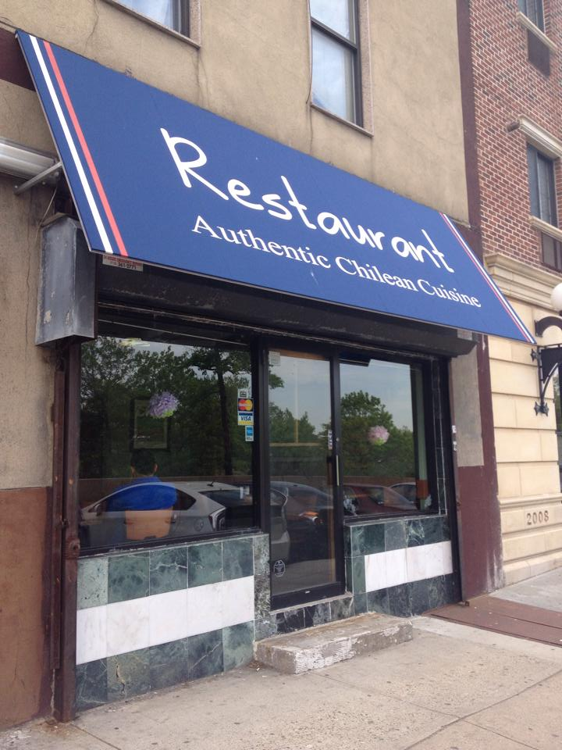
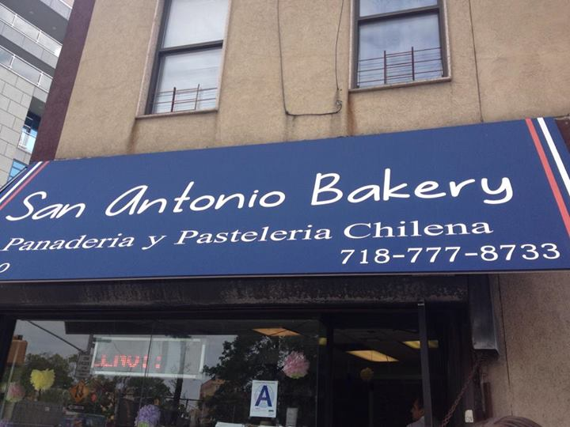
San Antonio Bakery

Slide 3
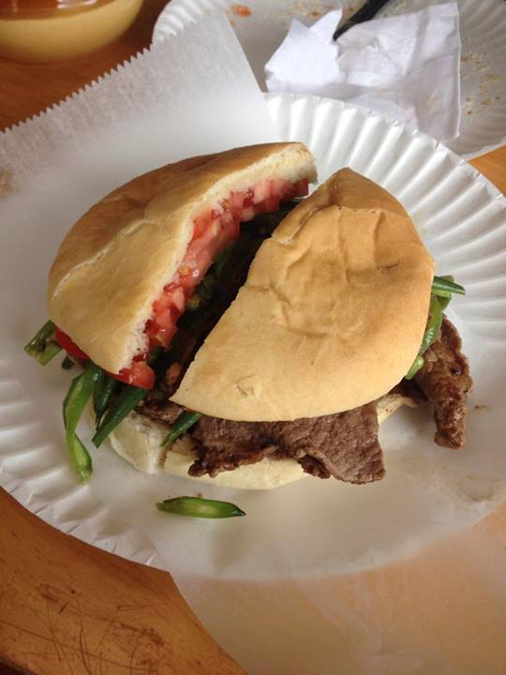
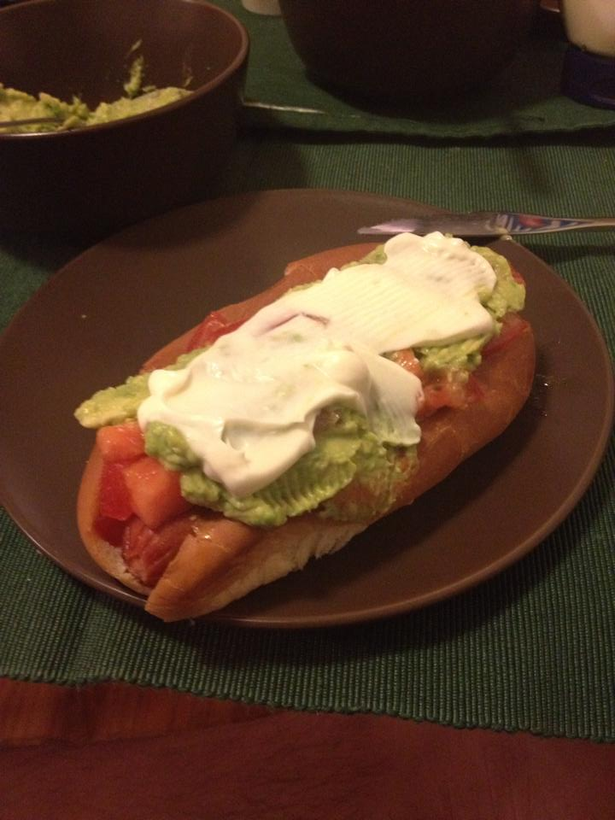
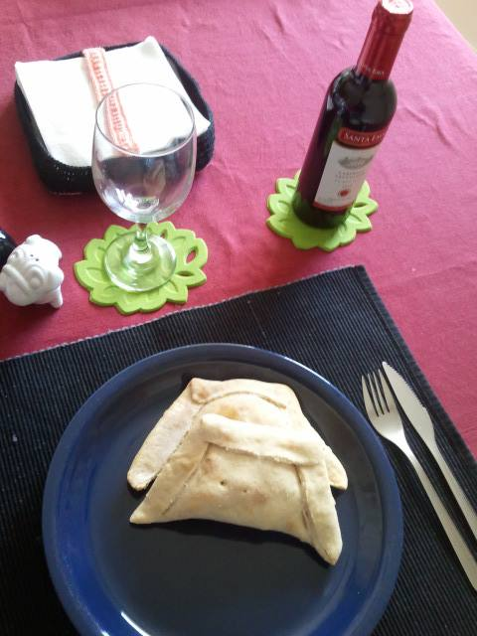
The Food Chacarero Hot Dog (Completo Italiano) Corn Pie (Pastel de choclo) Empanadas

Slide 4
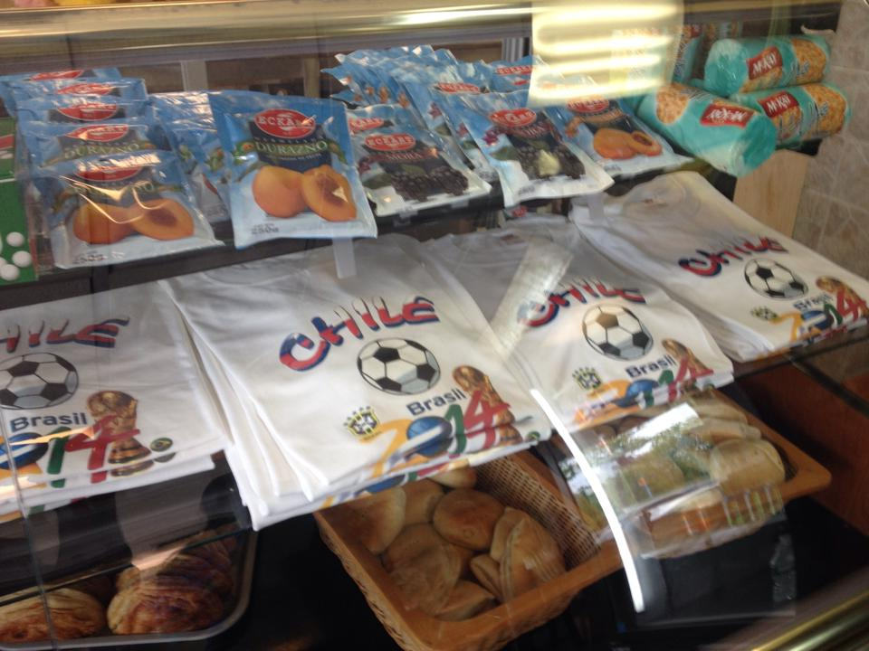
What can I find there?

Slide 5
HOW TO GET THERE? 3620 Astoria Boulevard, Astoria, NY 11103

Slide 6
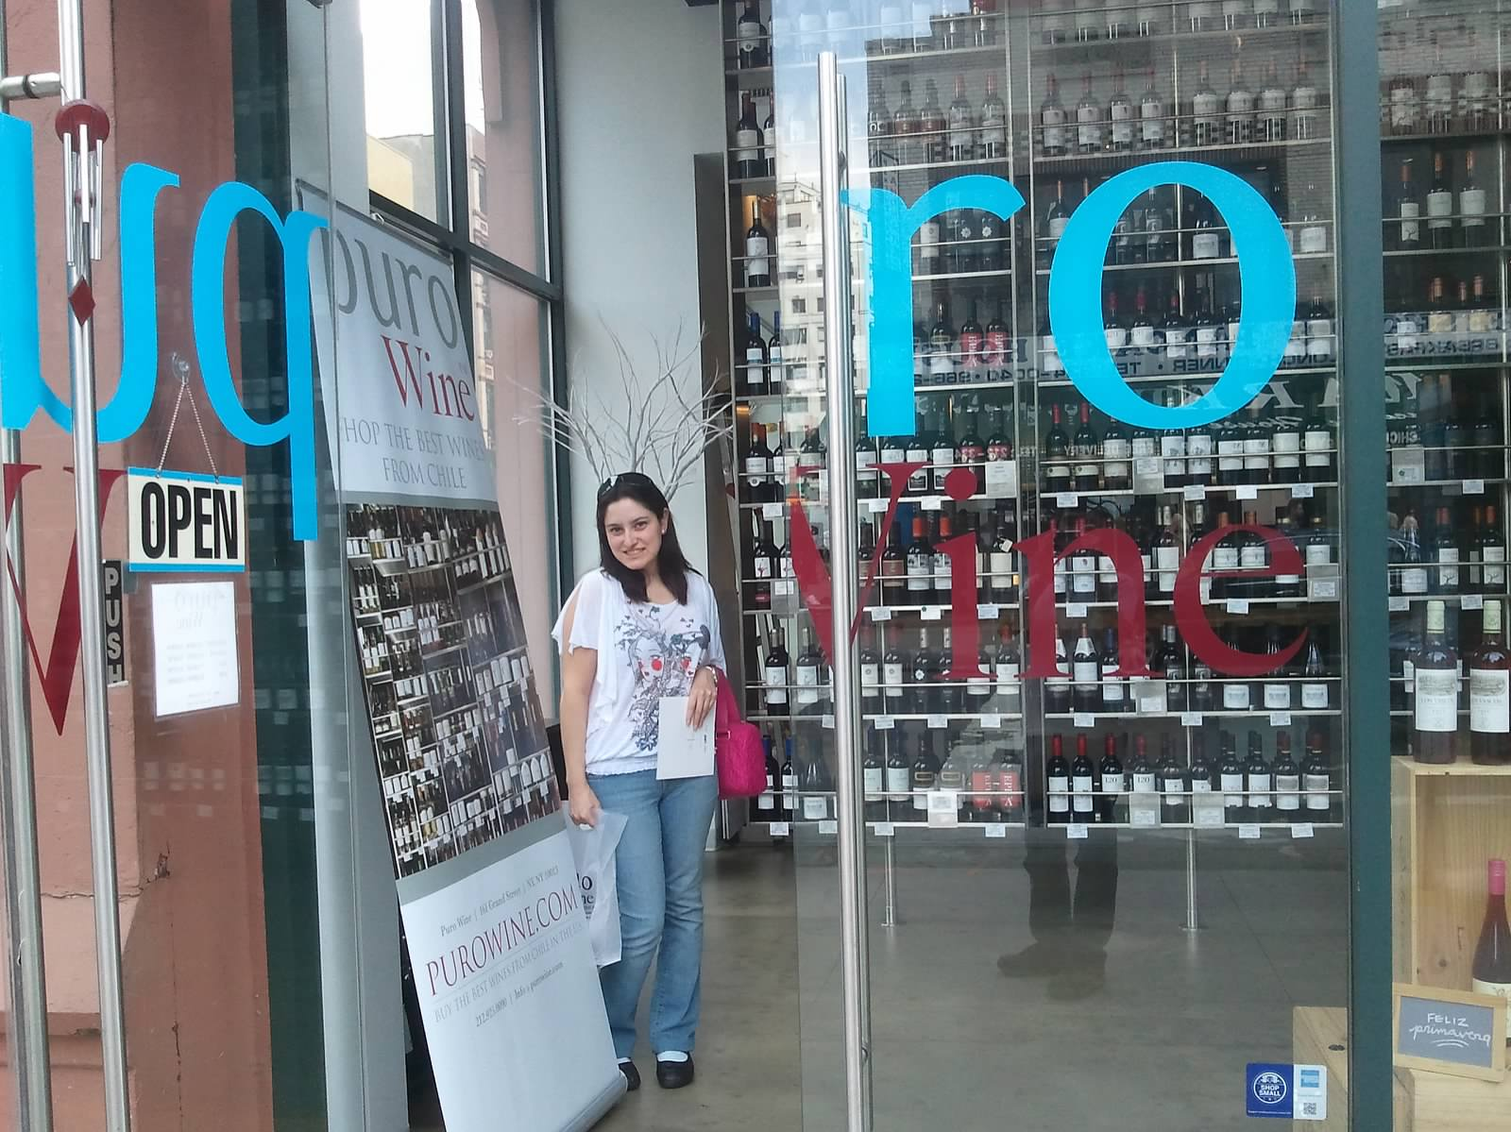
PURO CHILE

Slide 7
HOW TO GET THERE? 221 Centre St., New York, NY 10013

