Slide 1
Please sit with your critique partner
Ayako | Jesus
Nasser | Noriko
Melissa | Masayo
Carolina | Sawako
Makoto | Alejandra
Danilo | Mami
Yuka | Maho

Slide 2
CEP 6.9
Andras & Ruey-Ying

Slide 3
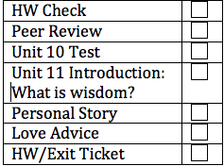
Today’s Lesson
HW Check
Peer Review
Unit 10 Test
Unit 11 Introduction: What is wisdom?
Personal Story
Love Advice
HW/Exit Ticket

Slide 4
HW Check
Check Your Knowledge:
purposes
theory
lake
sophisticated
carve
transported
Locate
Sentences:
It must have been those kids from next door!
It may be out playing with other cats.
It could have been our dog because he likes to roll in the flowers.
It might have been from the heat.
Oh, those people? They could be from the circus.
Did you check your mailbox? You roommate may have taken the mail!

Slide 5
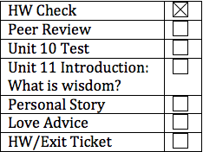
Peer Review
Let’s give some feedback for
letter we read.
Take 1 minute to review what you wrote
Round 1 (5 mins):
Choose who will go first
Share feedback
Round 2 (5 mins):
Feedback for the other person

Slide 6
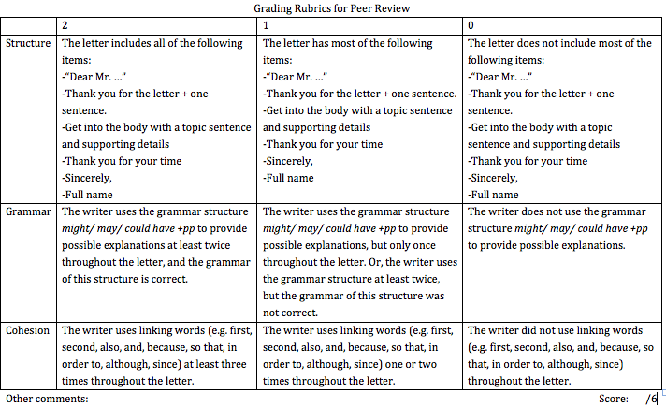
Peer Review (rubric)

Slide 7
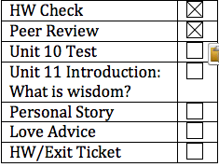
Unit 10 test!
Good luck!

Slide 8
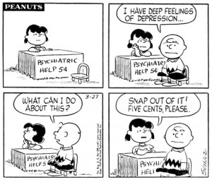
Unit 11: Sadder but Wiser

Slide 9
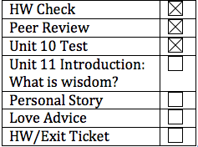
wisdom
What is wisdom?
Dictionary definition: the quality of having experience, knowledge and good judgment
What does wisdom mean to you?
Do you consider yourself wise?
Who do you consider a wise person? In your life, and in history? Ex. George Washington
How do you become wise?

Slide 10
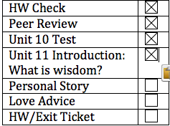
Personal Story
Have you had an experience that made you sadder, but wiser?
Take 3 minutes to think.
Share with your peers.

Slide 11
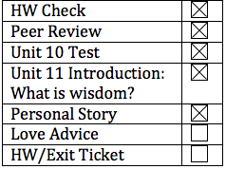
Dear Abby
A very famous advice column
Read the “Dear Abby” letter, and write down your advice

Slide 12
Dear Abby,
My boyfriend and I just moved to this new city together because my boyfriend, Adam, is going to graduate school. We hadn't lived together before, and I'm not sure I'm doing the right thing.
I’m working and paying for everything, and Adam is just going to school. He thinks this is a fair trade-off because "we won't have to worry about money at all" once he has completed his education.
Abby, I don't think he cares that it's ME moving here with him. How can I find out his true feelings and intentions? I do love him, but I worry this will end badly. Please give me some advice.
--Move to Indiana

Slide 13
Abby’s reply
You do need advice — and here it is: Your woman’s intuition is telling you this isn’t right, and that your boyfriend can’t be trusted to fulfill his part of the bargain. You should listen to it.
The person you have described is someone centered solely upon himself and his own needs. A man who doesn’t make you feel special, wanted or important would make a very poor husband.

Slide 14
Grammar Point: Advice/Criticism/Regret (p 109)
Tonight’s homework involves this grammar point:
Should + have + past participle (talking about the past)
Ought to + have + past participle
What do you think I should have done?
You shouldn’t have drunk all that milk before you ran the marathon.
I think you ought to have asked her out.
I should have invested in Google 10 years ago…

Slide 15
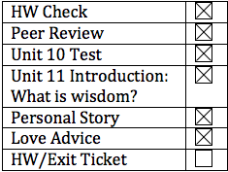
HW/Exit Ticket
Sign up for your presentation!
Textbook p.109, practice 5
Textbook p.110, practice 1
Structure log
Go to our class website and read other people’s structure log.
Report one phrase/sentence that you find interesting tomorrow.

Slide 16
See you tomorrow!

