Slide 1
CEP I6 June 5, 2014

Slide 2
Today’s Lesson
Warm-up: Peer Check
Listening Activity
Reading Activity
Pronunciation
Speak Out! (not really)
Presentation Model
See ya~
Warm-up: Peer Check Sentences
Listening and Speaking
Reading Activity
Pronunciation
Speak Out! (not really)
Read to catch the main idea
Presentation Model
See ya~

Slide 3
Peer Critique (check)
Warm-up: Peer Check
Listening Activity
Reading Activity
Pronunciation
Speak Out! (not really)
Presentation Model
See ya~
With your partner, check the sentences
Word choice error
Grammar error

Slide 4
Tropical rain forests
Warm-up: Peer Check
Listening Activity
Reading Activity
Pronunciation
Speak Out! (not really)
Presentation Model
See ya~
Ecosystem: all the animals and plants of a particular area and the interdependency between them.
What do you know about rain forest ecosystem?
Are they facts or opinions?

Slide 5
Facts and opinions
Practice 2 (p.102)- For each item, predict whether it is a fact or an opinion.
Listen for the signals of facts/ opinions to confirm your prediction.

Slide 6
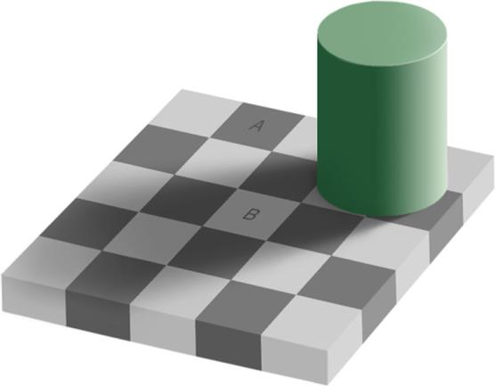
Trick of nature
Warm-up: Peer Check
Listening Activity
Reading Activity
Pronunciation
Speak Out! (not really)
Presentation Model
See ya~
Which is darker, block A or block B?

Slide 7
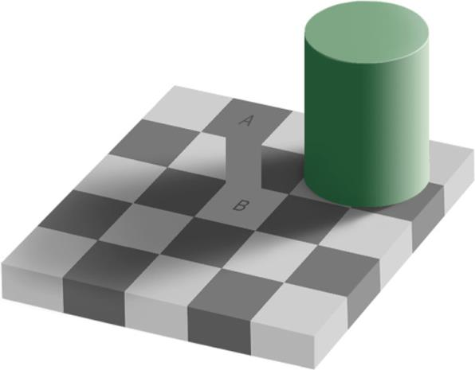
The colors are the same!
Optical illusions

Slide 8
Read the paragraph on p.105.
What are some examples of the laws of the nature?
What are some of the strange things that happen in the Oregon Vortex?
What are some theories about why the natural laws are different for some places on earth?

Slide 9
Underline three examples of facts and three examples of opinions.
What words or context helped you distinguish among them?

Slide 10
The Oregon Vortex!
https://www.youtube.com/watch?v=-KdxYT0Ngnc
Let’s try 30 second clips:
First 30 seconds:
Laws of physics suspended!
What kind of place is this? The narrator mentions 4
Next 30 seconds
Science has gone haywire! What does this mean?
Next 30
What kind of place did this used to be?
Is the broom standing straight up?
Next 30
Height changes? Can you explain this? Does this make sense?

Slide 11
2:00 – 2:30
What is interesting about the picture?
What is strange about the golf ball?
Any explanation?
2:30 – 3:00
What type of scientist is the professor?
What might explain the vortex? (2 answers)
3:00- 3:30
How many people come here each year?

Slide 12
Do you think this is a hoax?
Do you think that other places like this exist?
Do you know any other places that exist like this?

Slide 13
Pronunciation
Warm-up: Peer Check
Listening Activity
Reading Activity
Pronunciation
Speak Out! (not really)
Presentation Model
See ya~
What is this: /ə/? /ə/ = uh
Rule: have in front of consonants reduces to /əv/ or /ə/. Have in front of vowels ONLY reduces to /əv/.
He may have gone to the store.
She could have eaten the pizza.
There is no way she could have taken the money!
He couldn’t have invented high heels!
Yes, he could have.
Oh, he may have, but I am not sure.
/əv/ or /ə/
/əv/
/əv/ or /ə/
/əv/
/əv/
/əv/

Slide 14
Could have = /kudəv/ or /kudə/
Might have = /maɪtəv/ or /maɪtə/
May have = /maɪəv/ or /maɪə/

Slide 15
Speak Out! (but not really this time)
Warm-up: Peer Check
Listening Activity
Reading Activity
Pronunciation
Speak Out! (not really)
Presentation Model
See ya~
Instead of doing speaking, we are going to use these paragraphs to check main ideas and supporting ideas.
Read the short paragraph about Stonehenge (p.103). Underline the main idea and supporting ideas.

Slide 16
Presentation
Warm-up: Peer Check
Listening Activity
Reading Activity
Pronunciation
Speak Out! (not really)
Presentation Model
See ya~
Next week we are going to start presentations.
3 minutes long
Suggest something you like in New York
Suggest a place to eat (restaurant)
Suggest a fun place to visit (park, museum, bar)
A fun place to shop
A fun day trip away from the city
What can you do there? Why go? How do you get there?

Slide 18
Have a great weekend!

