Slide 1
Ruey-Ying and Andras CEP June 2nd, 2014

Slide 2
Today’s class:
Share structure lob notes
Feedback from the written HW
Review homework and do some additional review questions
Unit 9 test ☺
Unit 10 Introduction: Mysteries of Science!

Slide 3
WB Practice 8
Why do people install car alarms?
People install car alarms in their cars (in order) to protect the car from thieves.
People install car alarms so (that) the car will not be stolen.
Why do more and more people take trips abroad?
People take more and more trips abroad (in order) to learn about new places.
People take trips abroad so (that) they can sightsee.
Why are more and more people learning to access the Internet?
More and more people are learning to use the Internet (in order) to talk to their friends in other countries
People are learning to use the Internet so (that) they can online shop.
Why do more and more people continue studying after h.s.?
People continue to study after h.s. (in order) to learn new things.
People continue to study after h.s. so (that) they can get better jobs.

Slide 4
Check Your Knowledge (p 72)
Vocabulary Check
replace
estimates
convert
remodeling
plumbing
install
Check your understanding
fix
(in order) to
checked
so (that)
repaired
so (that)
cleaned
to install
wash
so (that)

Slide 5
Think about this… (7 places)
A: Do you want to go to the movies?
B: Yes, but tomorrow. I’ll get my friend buy us a ticket.
A: Why not today? I want to see X-Men!
B: I need have the plumber fix my sink at 6pm.
A. Oh, you should have that to fixed so that to not leak everywhere.
B. What a mess. Maybe I will make my landlord fix it earlier instead.
A: Don’t get the sink to repaired him! He broke your toilet last time.
B: I will make him fix it so that we would go to the movie!

Slide 6
And the answers…
A: Do you want to go to the movies?
B: Yes, but tomorrow. I’ll get my friend to buy us tickets.
A: Why not today? I want to see X-Men!
B: I need to have the plumber fix my sink at 6pm.
A. Oh, you should have that fixed so that it does not leak everywhere.
B. What a mess. Maybe I will make my landlord fix it earlier instead.
A: Don’t get the sink repaired by him! He broke your toilet last time.
B: I will make him fix it so that we can go to the movie!

Slide 7
Unit 10: Mysteries of Science
What is mystery?
Some mysteries have been solved by scientist (e.g. learning about other planets)
What else?
However, there are still mysteries that can not be explained by science.

Slide 8
Video: Top 10 unexplained mysteries
You are going to watch a video about 10 mysteries. Try to remember what they are!
https://www.youtube.com/watch?v=krF_zax8QXU&feature=kp
How many mysteries do you remember? Share with your partner.

Slide 9
Now, choose three of the mysteries that you’re interested in the most.
We are going to watch the video again. For the three mysteries you choose, answer the following questions:
What is the phenomenon?
What are the possible theories?

Slide 10
Are there any other mysteries that you have heard of?
What are the possible theories?
Homework for today: Do your own research!
Andras and Ruey-Ying’s presentations

Slide 11
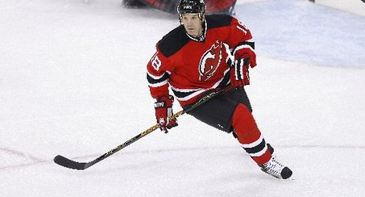
The Jersey Devils

Slide 12
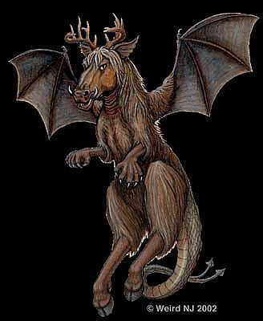
The Jersey Devil

Slide 13
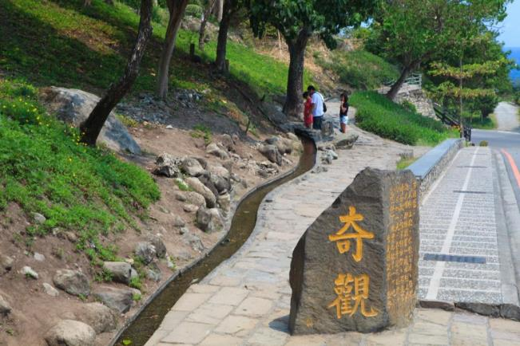
Water running uphill

Slide 14
The X-Files
https://www.youtube.com/watch?v=rbBX6aEzEz8

