Slide 1
CeP 6.23 Final Week
Andras & Ruey-Ying

Slide 2
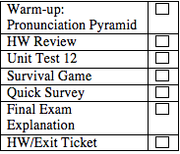
Today’s Lesson
Warm-up: Pronunciation Pyramid
HW Review
Unit Test 12
Survival Game
Quick Survey
Final Exam Explanation
HW/Exit Ticket

Slide 3
Pronunciation Pyramid!
Take a look at the pyramid.
This time it focuses on word stress.
We can try as a class first, then try in groups.

Slide 4
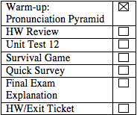
HW Check: Practice 4 (p.90)
(make sure to ask your groups if there are any questions)
knew
were
had moved
had

Slide 5
HW Check: Practice 5 (p.91)
had won
would start
had thought
would do
would do
would double
had paid

Slide 6
HW Check: Check Your Knowledge (p.94)
Vocabulary Check
disposal
voluntary
regulations
weapons
extinction
benefit

Slide 7
HW Check: Check Your Knowledge (p.94)
A.
Wishes for past changes:
I wish I had been a better student and had studied harder in school.
I wish I had saved more money when I was younger
Wishes for present change:
I wish I were able to fly so I wouldn’t have to take public transportation.
I wish I could study in the CEP Friday, Saturday, and Sunday too!
Wishes for future improvements:
I wish New York would clean it’s subways.
I wish I could take a trip to California and enjoy the beaches!
B.
I wish my boss were able to give me more time off.
I wish I could be paid more.

Slide 8
Any last minute Questions??

Slide 9
Unit 12 Test

Slide 10
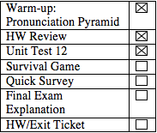
Survival Game
You and your companions have just survived the crash of a small plane. Both the pilot and co-pilot were killed in the crash. It is mid-January , and you are in Northern Canada. The daily temperature is 25 below zero, and the night time temperature is 40 below zero. There is snow on the ground, and the countryside is wooded with several creeks criss-crossing the area. The nearest town is 20 miles away. You are all dressed in city clothes appropriate for a business meeting. Your group of survivors managed to salvage the following items:
Notes:
http://scoutingweb.com/scoutingweb/SubPages/SurvivalGame.htm

Slide 11
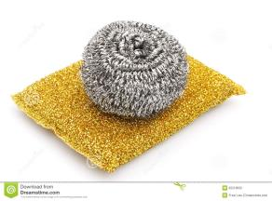
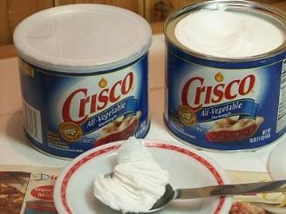
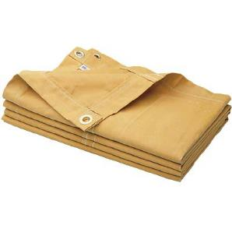
You have these items:
A ball of steel wool
A small ax
A loaded .45-caliber pistol
Can of Crisco shortening
Newspapers (one per person)
Cigarette lighter (without fluid)
Extra shirt and pants for each survivor
20 x 20 ft. piece of heavy-duty canvas
A sectional air map made of plastic
One quart of 100-proof whiskey
A compass
Family-size chocolate bars (one per person)

Slide 12
Task
(hint, you have decided not to try to go to town, but wait for assistance)
Which items are the most useful?
Pick 5, and rank them from 1 (most useful) to 5

Slide 13
Based off US Army
Cigarette lighter (without fluid)
Ball of steel wool
Extra shirt and pants for each survivor
Can of Crisco
20 x 20 foot canvas
Small ax
Chocolate bars
Newspaper
Pistol
Whiskey
Compass
map

Slide 14
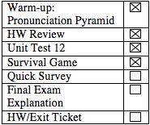
Survey
(I’m not sure if we are using class time to fill out the survey or just introduce the survey and let them do it at home)

Slide 15
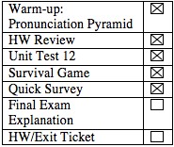
Final Exam Explanation
There will be 5 sections:
Grammar
Listening
Speaking
Reading Writing
All of the units will be on the test, so review all the grammar.
Speaking test explanation

Slide 16
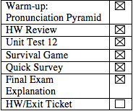
HW/Exit Ticket
Textbook p 127 + 128 (review)
Textbook p 96 practice 4 + 5
Any other review you want to do, bring us questions
Write on the exit ticket
Email us or upload a file to dropbox

Slide 17
See you tomorrow!

