Slide 1
Unit 12: Wishful Thinking

Slide 2
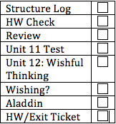
Today’s Lesson
Structure Log
HW Check
Could/Would Review:
Last Q+A before test
Unit 11 Test
Unit 12: Wishful Thinking
Wishing?
Aladdin and the Magic Lamp
HW/Exit Ticket

Slide 3
Structure Log
How was your weekend?
Structure Log:
http://tccepi6.weebly.com/structure-loggrammar-help-blog.html#/

Slide 4
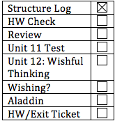
HW Check: Check Your Knowledge
Check Your Knowledge:
Vocab Check:
Condition
Admit
Surgery
Ulcer
Dependable
wreck
Windshield
Tire
Highlights
struck

Slide 5
Check Your Understanding
Check Your Understanding
Possible Answers:
If Jan hadn’t taken her father’s car without permission, she would be able to go to the party.
If Steve hadn’t forgotten to take his passport to the airport, he would be able to take the flight.
If Mario and Ali hadn’t moved to France, they would still have their good jobs in Italy.
If I hadn’t forgotten to tell Teresa I wanted to buy her computer, she wouldn’t have sold it to Carol.
If Dan hadn’t bought a new car, he would have enough money to pay his bills.

Slide 6
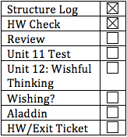
Could vs. Would Review
Use with 3rd conditional:
If + somebody/something (subject) + had (not) past participle, subject could/would + have past participle…
If Carla had not gone to the store, she couldn’t have bought groceries.
If Carla had not gone to the store, she wouldn’t have had food.

Slide 7
If she had had an umbrella, the rain couldn’t have rained on her.
If she had had an umbrella, she wouldn’t have been rained on.

Slide 8
Advice, Criticism, Regret
You should …
You should have …
Should I have … ?
I (or it) should have …
You should go see the doctor.
You should have seen the doctor 2 days ago, now it is really bad.
Should I go see the doctor?
I should have gone to the doctor sooner.
Advice
Criticism
Advice
Regret

Slide 9
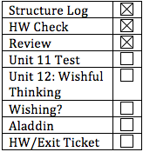
Unit Test 11

Slide 10
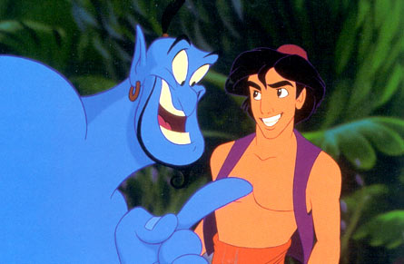
Unit 12: Wishful Thinking

Slide 11
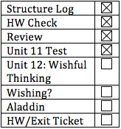
Phantom of the Opera
1910 novel by Gaston Leroux
1986 musical adapted by Andrew Lloyd Webber
What is the plot?

Slide 12
Christine is torn between Raoul and the Phantom. She doesn’t know what to do and visits her father's grave.
Read the lyrics. Look at the words around the blanks. What might the words be?
Listen to this YouTube clip.
Fill in the blanks as you hear it.

Slide 13
Phantom of the Opera
https://www.youtube.com/watch?v=LSRNjnpM7y4

Slide 14
Try to catch anything you missed.
If you have all the blanks, look at the lyrics and her acting. What is her wish?
Discuss the answers with your partner.

Slide 15
Blank Answers:
5. you were
6. you were
8. you would
9. I could
10. would
11. won’t help
18. can’t
19. you were
20. we must

Slide 16
What is Christine’s wish?
Is it likely that her wish will come true?
HW for tonight: wish for changes to the present.

Slide 17
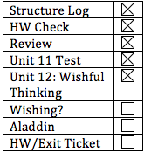
What is wishful thinking?
What is wishful thinking?
What is a wish?
Talk about this in your pairs.

Slide 18
Textbook p 112
Making a Wish, #3
Are these ways of wishing unique to the USA?
What are some ways people make wishes in your culture?
Do you think there are any unique ways of wishing in your culture?

Slide 19
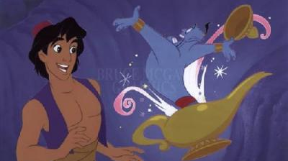
Aladdin and the magic lamp
Does anybody know this story?

Slide 20
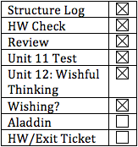
Making a Wish
What are Aladdin’s wishes?
1. Aladdin wishes to become a prince.
2. Aladdin wishes to be saved from drowning.
3. Aladdin wishes to free Genie.
What would you wish for? Why?
I wish I were taller.
I wish I could graduate from Columbia already!
I wish I were able to fly.

Slide 21
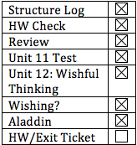
HW/Exit Ticket
Light Night!
Textbook p 120 present tense wish
Upload something on the Structure Log Blog if you haven’t already
Presentation Tomorrow:
Mami
Yuka
Noriko

