Slide 1
Unit 11 Sadder But Wiser 6.11
Andras & Ruey-Ying

Slide 2
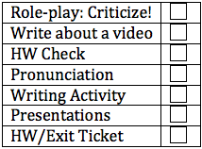
Lesson Plan
Role-play: Advice/Criticize
Conditional Practice: Write about a video
HW Check
Pronunciation: shoulduv/shoulda’
Writing Activity
Presentations: Makoto, Danilo, Nasser
HW/Exit Ticket

Slide 3
Role-Play: Advice or Criticism
Homework Prompts:
You insulted your boss and were fired by him. Try to apologize for what you have done. Tell him/her what you SHOULD have done.
OR
You are a coach and your team just lost the game. Describe what happened and tell them what they OUGHT TO have done.
Take 1 minute to think about what you said.
Get in groups of people with a similar prompt.
Compare your suggestions.

Slide 4
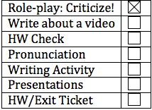
Frasier!
Famous American sitcom.
Niles is having a date coming over for dinner. What should he do in order to have a better outcome?
When you watch the video, think about:
What happened?
What would have happened if Niles had done it differently?
What is likely to happen next?

Slide 5
What happened?
What would have happened if Niles had done it differently?
If he hadn’t noticed a loose thread on his pants, he would have kept ironing his pants.
If he hadn’t been distracted by the dog, he wouldn’t have cut his finger.
What is likely to happen next?
If he leaves the iron on his pants, his pants will be burned.

Slide 6
Frasier clip
https://www.youtube.com/watch?v=6mWiPaQ872c

Slide 7
We will pause the video four times. Each time we pause the video, write down two sentences:
1. What would have happened if Niles had done it differently?
If he had..., he(or something) would/could have...
2. What is going to happen next?
If he..., he (or something) will...

Slide 8
1. What would have happened if Niles had done it differently?
If he had..., he(or something) would/could have...
2. What is going to happen next?
If he..., he (or something) will...

Slide 9
1. What would have happened if Niles had done it differently?
If he had..., he(or something) would/could have...
2. What is going to happen next?
If he..., he (or something) will...

Slide 10
1. What would have happened if Niles had done it differently?
If he had..., he(or something) would/could have...
2. What is going to happen next?
If he..., he (or something) will...

Slide 11
1. What would have happened if Niles had done it differently?
If he had..., he(or something) would/could have...
2. What is going to happen next?
If he..., he (or something) will...

Slide 12
Did you correctly predict the outcome? Share your sentences with your partner.

Slide 13
HW Check
Please take out your HW.
Let’s look at p 109, #2.
Did Mia win the piano competition?
If Mia had practiced harder, she could have won the piano competition.
What did she spend her time doing, why?
Yeah, I guess if she hadn’t been so confident, she would have spent more time playing the piano and less time at the mall.
The assignment was p 109, 2, 3, and 4. Check your work with your partner, then we will put the answers on the board.

Slide 14
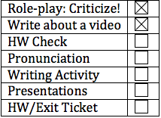
HW Check
A. 1. had known
2. wouldn’t have put
B. 3. hadn’t eaten
4. would have had
Schistosomiasis???? It is a parasite, a disease.
C. 5. wouldn’t/couldn’t have spread
6. hadn’t been
D. 7. hadn’t grown
8. would/could have caught
E. 9. had been
10. would/could have had
F. 11. hadn’t been
12. could/would have dried
G. 13. could/would have smoked
14. had had

Slide 15
Hw 4
Martin struck to his exercise program, and he didn’t gain a lot of weight.
Khalid didn’t take my advice, and he bought the cell phone.
Lin didn’t practice hard enough, and she didn’t win the competition.
Angela didn’t tell the truth, and she wasn’t so happy.
The building didn’t have a fire alarm and one or more people were hurt.

Slide 16
3rd Condiontional
If + past participle, would/could have + past participle.
Could vs would have
If he hadn’t ironed his pants, none of this would have happened.
If he hadn’t ironed his pants, he could have had the date at his house.
The dog wouldn’t have eaten the food on the table if the man hadn’t been distracted.
*note: position, connection to person and could.

Slide 17
Past vs future… is this still 3rd conditional?
If he sees blood, he will faint again.
(future, prediction)
If he hadn’t put oil on the couch, it wouldn’t have caught fire!
(past, criticism)

Slide 18
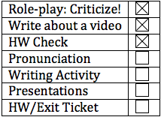
Pronunciation
What is the rule for have reduction when we studied could?
Rule: have in front of consonants reduces to /əv/ or /ə/. Have in front of vowels ONLY reduces to /əv/.
Same with should and would! Or may, might; any modal before have.
ALSO:
ʃʌdnəv = should’nuv (fast)
Wʌdnəv = would’nuv (fast)
ʃʌdnə = should’na (faster!)
wʌdnə = would’na (faster!)

Slide 19
Take 1 minute and look over the dialogue.
Let’s listen. You will hear it twice.
Practice with a partner.
**remember: if this is hard for you, don’t worry about it. It is enough to know. But it you think you are ready, try to use it. Don’t be afraid to experiment, especially here in class!

Slide 20
Answers (p 113):
Shouldn’t have
Wouldn’t have
Shouldn’t have
Should have
Should have
Would have

Slide 21
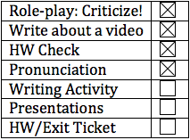
Writing- persuasive essay
What does “persuade” mean?
How do you persuade people to agree with you in your daily life?
What is a persuasive essay?
Write to persuade people with a particular opinion.
State your point of view.
Provide reasons why your readers should agree.
Conclusion: state your point of view again.

Slide 22
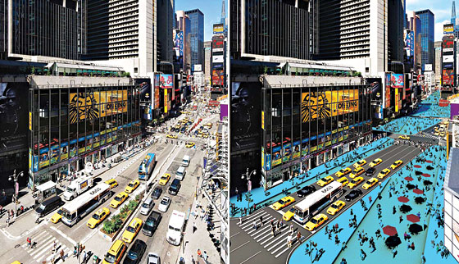
Time square
Did you know Time Square was not closed to traffic until 2009?

Slide 23
Closed to traffic
What are some reasons for closing Time Square to traffic?
What are some reasons for NOT closing Time Square to traffic?
Take a look at the similar scenario on p.116. The city decided to close 5th Ave. to traffic.
The writer thinks that the city should have done this earlier. Read the paragraph.

Slide 24
Back to time square
In 2010, Mayor Bloomberg announced the pedestrian plazas in Time Square will remain permanently.
Read the paragraph from the New York Times.
What is the main idea of this paragraph?
What are the reasons to support this point of view?
Let’s create an outline for this paragraph!

Slide 25
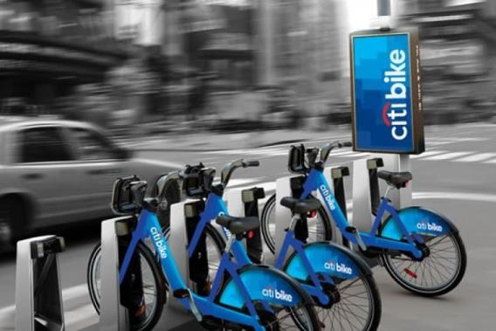
debate!
CITI Bike
Public bike sharing system that serves parts of NYC

Slide 26
Count off 1’s and 2’s
Argument:
1. NYC should continue with the CITI Bike program.
2. NYC should have terminated the CITI Bike program.
Use the chart and brainstorm the reasons to support your argument.
Meet with your team to compare your charts.
Debate tomorrow!

Slide 27
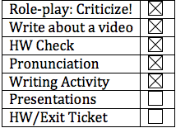
Presentations
Today’s line-up
Makoto
Danilo
Nasser

Slide 28
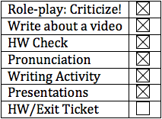
HW/Exit Ticket
Workbook practice 4, 8, and 9 (p.83+p.85)
Prepare for the CITI Bike debate:
2 minutes
A clear point of view, at least 2 reasons and supporting details, and a strong conclusion.
If you want to practice, you can record and upload your audio file (optional)
Prep if you have a presentation tomorrow
Carolina, Sawako, Jesus

