Slide 1
Unit 11: Sadder but wiser 6.10
Ruey-Ying & Andras

Slide 2
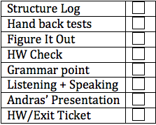
Today’s Lesson
Structure Log
Hand back tests
Figure It Out (Reading about Advice)
HW Check
Grammar point: should + have + past participle
Listening + Speaking: How does your culture deal with compliments and criticism?
Andras Presents… Surprise!
HW/Exit Ticket

Slide 3
Structure Log
Let’s take a look: here are some of the phrases from the structure log:
How was it? Are you flirting with me!
It is on me.
The sky is the limit.
If you would like to see the world clean, start sweeping in front of your house
It isn't a big deal.
It is fashionably late.
Stay in touch.
The rats are like cats here!
Shake like a leaf.
It doesn't sound jelly!
Bling Bling

Slide 4
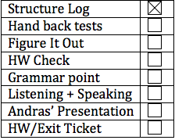
Test
Reminder: There will be 4 test, and a final.
We are going to drop the lowest grade, so if you did not do well on a test, or missed a test, it is ok. (But try not to miss any)
Unit 10 Test Average: 92%
!!!!! Great!!!!

Slide 5
Tests
Notes:
vocab: fish/fishes, bacterium/ bacteria

Slide 6
Essays
Overall, great!
Structure: we were looking for parts that make up a formal letter:
Dear XXX
Thank you for the letter…
Your claim, and some support
Thank you.
Sincerely,
Your name
Content: Good, solid reasons WHY
Cohesion: Linking words and logical flow
Grammar: Did you use the grammar structure at least twice?

Slide 7
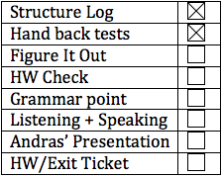
Figure it out
What happened?

Slide 8
Car accident
Read Conversation A (p.108)
What’s wrong with the car?
Who is the sadder but wiser person?
What advice had he received before he bought the car?
Does Hank give Tony advice about the current situation?

Slide 9
What is your advice for Tony? What do you think he should do now?
What is the difference between giving advice about the past and giving advice about the current situation?
Grammar structure
Tone

Slide 10
imagine a similar scenario...
You and your friend are going to the beach on his car. However, the car ran out of gas and stopped on the highway.
What could your friend have done to prevent this situation?
What would you advise your friend to do now?

Slide 11
Doctor’s visit
Read Conversation B (p.108)
Who is the sadder but wiser person?
What is wrong with him?
What had the doctor previously advised?
What does the doctor advise the patient to do now?

Slide 12
imagine a similar scenario...
You sprained your ankle a few days ago. You thought it was not a big deal, so you continued to walk around. However, your ankle got worse and now you can barely walk. You decide to visit a doctor.
What could you have done to prevent this situation?
What might your doctor advise you to do now?

Slide 13
Vocabulary check
1. h
2. d
3. g
4. f
5. c
6. a
7. b
8. e

Slide 14
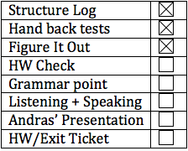
HW Check, p 109
You should have asked for directions.
You should have set your alarm clock.
You should have worn more comfortable shoes.
You should have tried them on in the store.

Slide 15
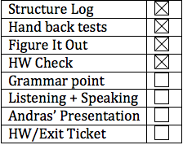
Grammar!
Advice, Criticism, Regret
Use should (not) + have + past participle
OR use ought (not) to + have + past participle
BUT, what does this mean?

Slide 16
She’s Back!!!!
Dear Abby,
My boyfriend and I just moved to this new city together because my boyfriend, Adam, is going to graduate school. We hadn't lived together before, and I'm not sure I'm doing the right thing.
I’m working and paying for everything, and Adam is just going to school. He thinks this is a fair trade-off because "we won't have to worry about money at all" once he has completed his education.
Abby, I don't think he cares that it's ME moving here with him. How can I find out his true feelings and intentions? I do love him, but I worry this will end badly. Please give me some advice.
--Move to Indiana

Slide 17
What is your advice?
Try the worksheet: 3 minutes.
Raise you hand when you are done.
What was her advice?
You should listen to it.
Listen to what? Her woman’s intuition.
You should …
You should have …
Should I have … ?
I (or it) should have …
(What is in the book? Advice, criticism, or regret?)

Slide 18
May/might/Could vs Should
You may/might break up with him.
You could break up with him.
You should break up with him
He might have bought the book, but I don’t know.
He could have bought the book, but I’m not sure.
He should have bought the book, now there are none left, so he can’t.
You could not have listened to him. He wasn’t there!
You should not have listened to him. He told you something incorrect.

Slide 19
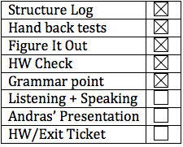
job performance
How is job performance evaluated in your work place?
How do you deal with people who work well in your work place in your own culture? What about those who do not?
How is it different in the US?

Slide 20
Listen and make inferences
You’ll listen to a conversation between the Personnel Director and students.
Making inferences: use the knowledge you have about the situation as well as other information that is explicitly stated.

Slide 21
Read the questions of Conversation 1.
Listen and make inferences.
a. N
b. N
c. Y
d. Y
Notes:
50

Slide 22
Read the questions of Conversation 2.
Listen and make inferences.
a. Y
b. Y
c. N
d. Y
Notes:
1:12

Slide 23
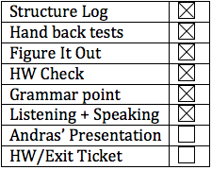
Presentation
What to pay attention to:
Does the story get your attention
Body Language
Speech speed and volume
Pronunciation
Have fun!

Slide 24
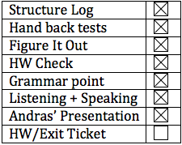
HW/Exit Ticket
Textbook practice 2 , 3, and 4 (p 110 + 111)
90 second audio file using the grammar point:
You insulted your boss and were fired by him. Try to apologize for what you have done. Tell him/her what you SHOULD have done.
OR
You are a coach and your team just lost the game. Describe what happened and tell them what they ought to have done.
Optional: p 108 basketball Q+A (note to self, post questions and answers on website in separate docs)
Prep if you have a presentation

Slide 25
Later!

