Slide 1
5.29 Andras & Ruey-Ying

Slide 2
Exercise 5
to wear
eat
decorated
Flooded
to make
brought in
built
prepare
dress
to sing

Slide 3
Exercise 6
Sadi is having a tune up done by a motorcycle shop.
Ali is having rose bushes planted in his back yard by a gardener.
Grace is having her basement checked for mice by an exterminator.
Ann is getting the new memory for her computer installed by the technician.
Keiko is getting a garbage disposal installed in her kitchen sink by a plumber.

Slide 4
Express Purpose
People have many reasons for doing the things they do.
Why did Liz take out a loan?
She took out a loan because she wants to remodel her house.
Or...

Slide 5
She took out a loan so (that) she could remodel her house.
She took out a loan (in order) to remodel her house.
Are the two sentences the same?
They have the same meaning, but...
(in order) to + verb
so (that) + clause

Slide 6
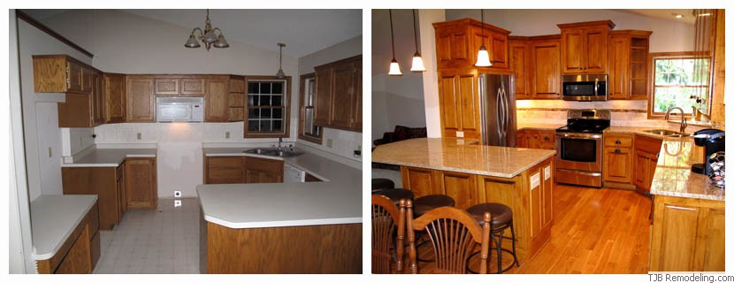
Liz just made kitchen improvements...
What did she do?
What was the purpose?

Slide 7
What kinds of improvements have you made or would you like to make to your apartment?
Why?

Slide 8
A special house
Listening to confirm predictions
Predict what a conversation will be about.
When you listen, focus on information that tells you whether your predictions are accurate or not.

Slide 9
1. 1884
2. 8
3. the Santa Clara Valley in California
4. Mrs. Winchester believed that spirits told her to change the design of the house
5. 22
6. 38
7. 160

Slide 10
Do you believe in the existence of ghosts or spirits? Why?
Have you heard any stories about spirits communicating with people?

Slide 11
Play palace
Did you have a favorite toy when you were a child? Tell your partner about the toy.
Did it have a special meaning for you?
How did you get it?
Do you still have it?

Slide 12
Describing a place
In your homework, how did you describe your apartment?
Spatial organization
from general to specific
from specific to general
from outside to inside
from inside to outside

Slide 13
While you read...
Underline sentences with the structures
have/ get/ make someone (to) do something
have/ get something done
Underline vocabulary that you want to learn

Slide 14
Picture 1

Slide 15
Picture 2

Slide 16
Picture 3

Slide 17
Brainstorming Chart

