Slide 1
Biking in NYC
Ruey-Ying Liu

Slide 2
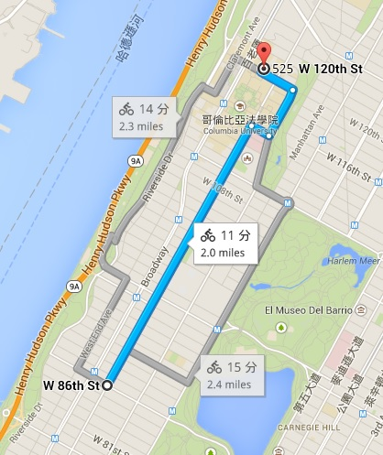

Slide 3
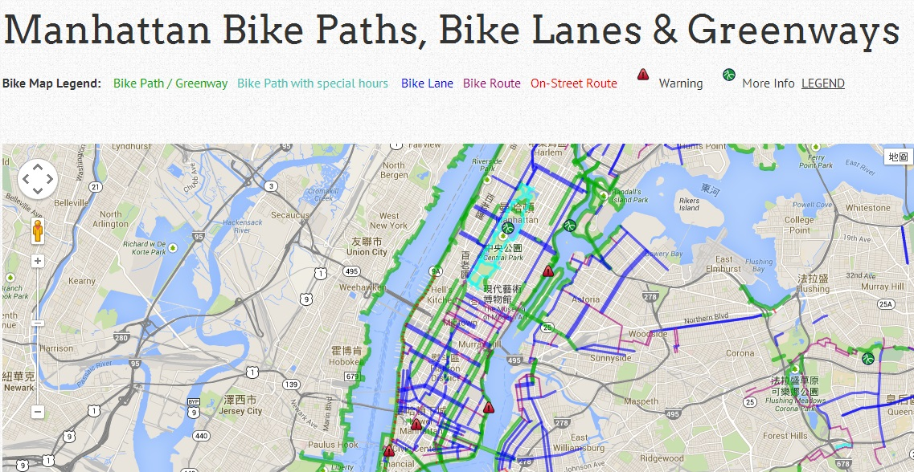

Slide 4
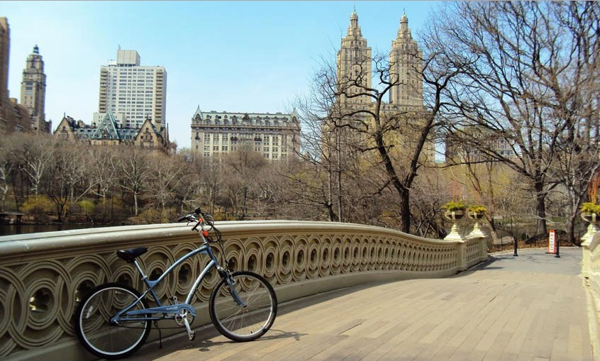
Central Park

Slide 5
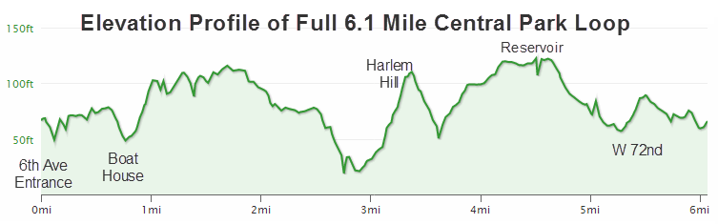

Slide 6
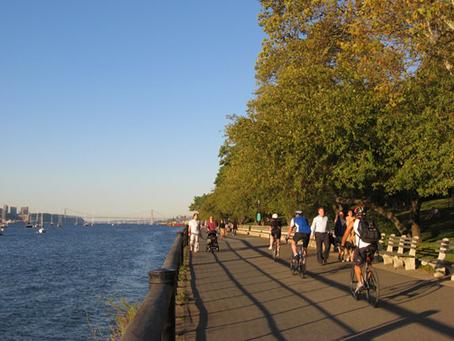
Hudson River Greenway

Slide 7
What do you need?
Bike!
Head light and tail light
Helmet
Lock
Optional: Goggles, gloves, cycling pants...

Slide 8
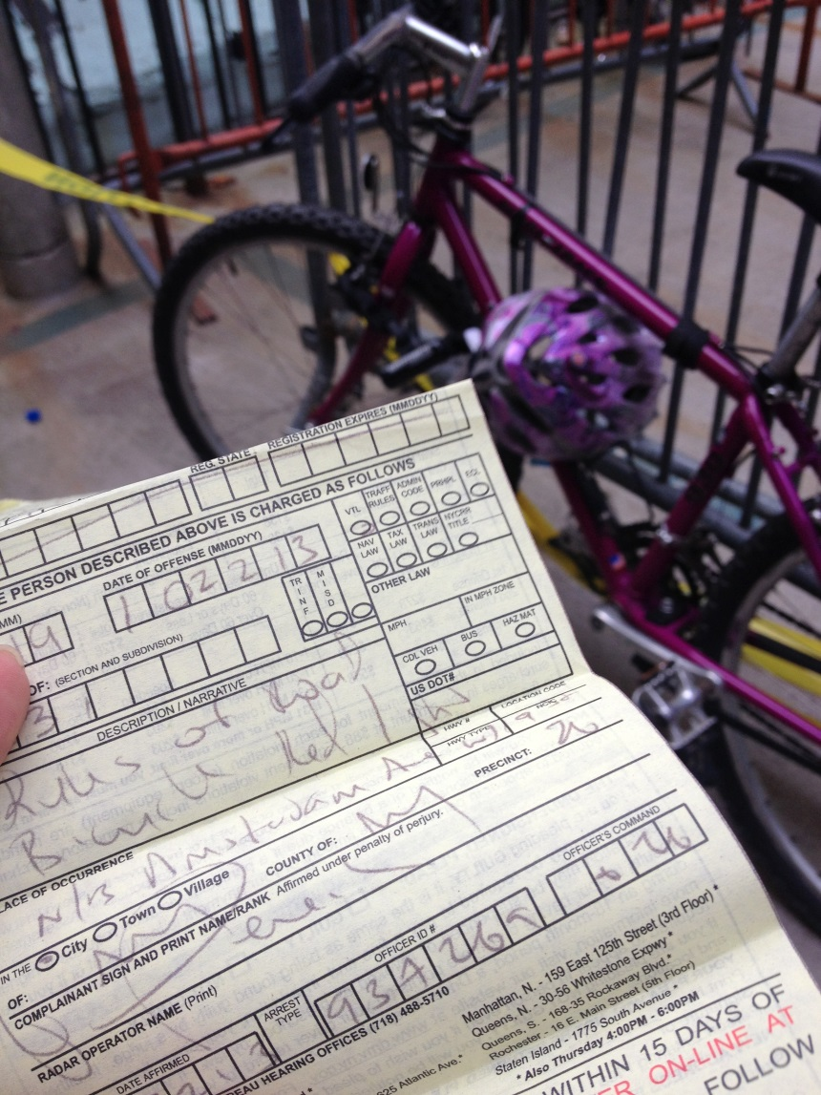
Stop for the red light!

